Slide 1
Key Stage 5

Slide 2
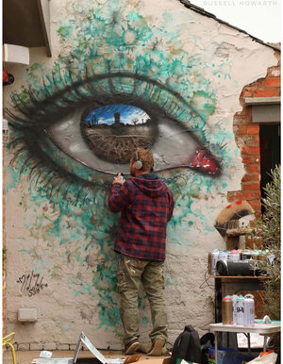
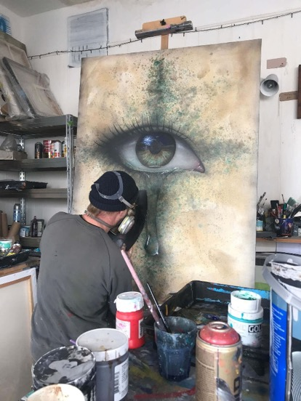
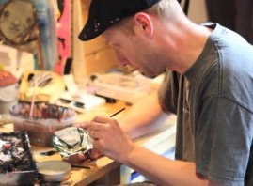
My Dog Sighs is a Portsmouth-based street artist.
He has been a practising artist for 20 years.
He is internationally known, holding exhibitions around the world including USA, Israel and Australia
Notes:
We’re going to be finding out about a street artist based in Portsmouth called My Dog Sighs.
My Dog Sighs has been a full-time artist for 20 years. He is well known internationally, holding exhibitions and displaying art in countries including USA, Israel and Australia.
However it wasn’t always like that…He was originally a teacher but his dream was always to be an artist. To start with he thought that to become a full-time artist he would need to paint the kinds of pictures you see in art galleries. Having spent a year painting those kinds of paintings, he took them round loads of galleries but they weren’t interested in paintings that looked like other people’s paintings.
In 2002 My Dog Sighs had his moment of realisation when he saw a Banksy painting on a wall in London. (Check they know about Banksy.)
He realised that to him, art was about stumbling across something unexpectedly that made you stop and think, and he was motivated by this. However by now he was a family man and didn’t want to start damaging people’s walls or risk getting arrested!

Slide 3
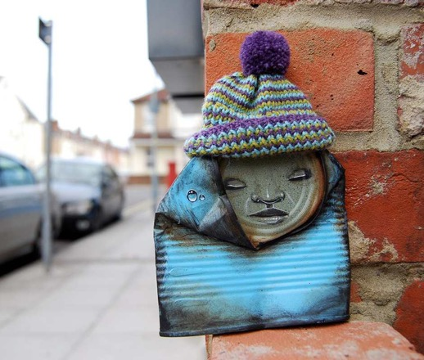
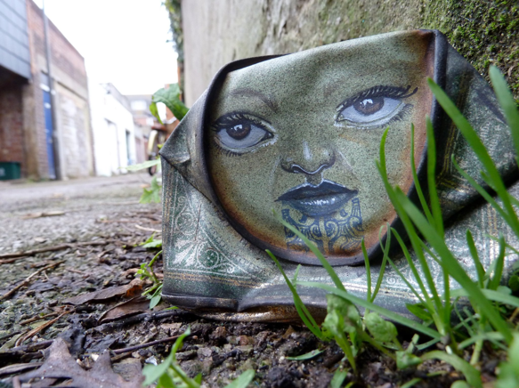
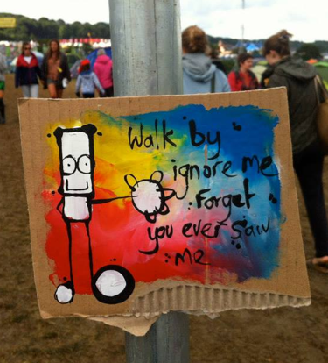
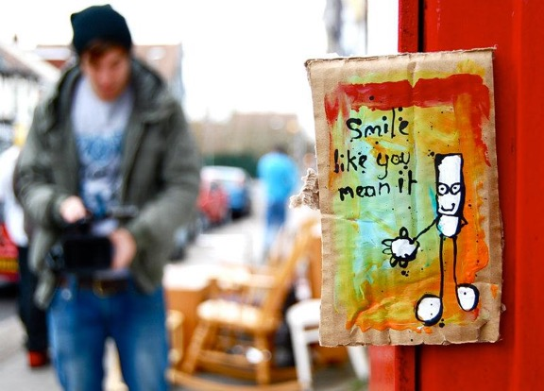
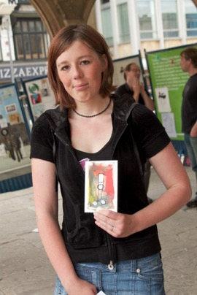
Free Art Friday
Look at the pictures –
what do you think
Free Art Friday is?
Notes:
Instead, about 10 years ago, he found another way to bring art to people unexpectedly, and My Dog Sighs started doing something which after a while became known as Free Art Friday. Looking at the pictures, can you guess what Free Art Friday is?
He started leaving a piece of his art somewhere in Portsmouth every Friday. He would leave a little tag on it saying ‘Free art. I’m yours. Take me home.’ Here you can see the types of art he would leave and photos of people who found some of his art.
He started to post pictures online of what he was leaving out and soon other artists started to follow suit. A Free Art Friday community began to grow online, with artists taking the idea and adjusting it to suit themselves and their environment. Soon these artists started sending each other their pieces of art to leave out in their hometowns.
Free Art Friday now happens all round the world with people leaving pieces of their art for others to pick up.
What do you like / not like about the concept of Free Art Friday?

Slide 4
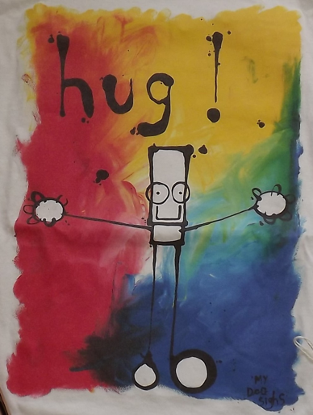
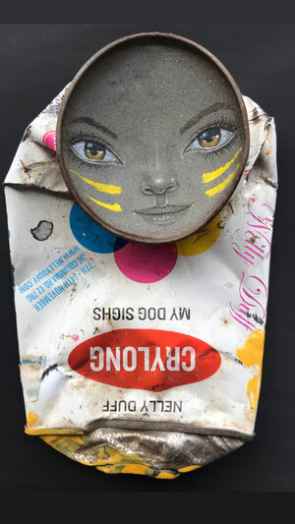
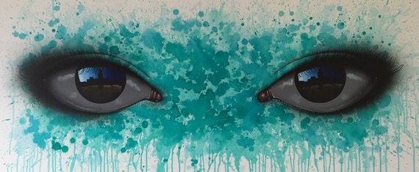
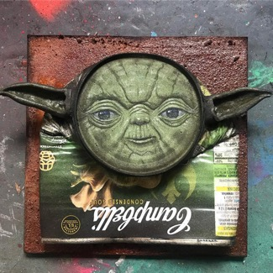
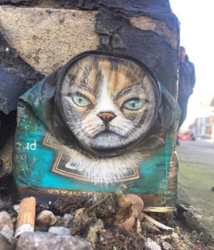
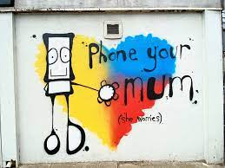
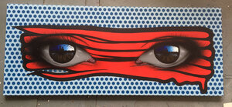
Notes:
From getting well-known for Free Art Friday, his life went crazy. He quickly went part time in his teaching job then gave in his notice and started painting full time. HIs feet haven’t hit the ground since. My Dog Sighs is best known for 3 particular styles.
Look closely at this slide; can you spot 3 themes?
The black and white character on the colourful background he calls Everyman. He often includes words from songs with it.
He creates characters with life-like faces out of found objects, for example crushed tins.
He’s well-known for his hyper-realistic eyes. (Hyper-realistic means that they look real but in an unusual or striking way.) What do you notice when you look closely at these eyes? (In the shiny surface of the eyeball he has painted a reflection of an image – it may be people, places or stories.)

Slide 5
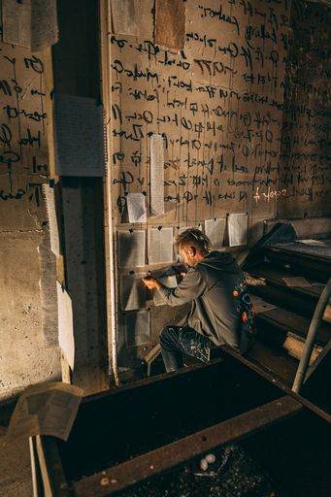
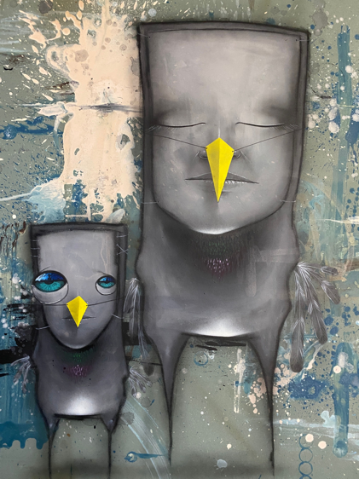
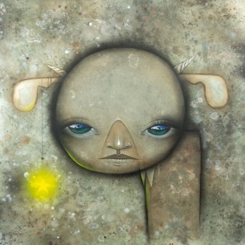
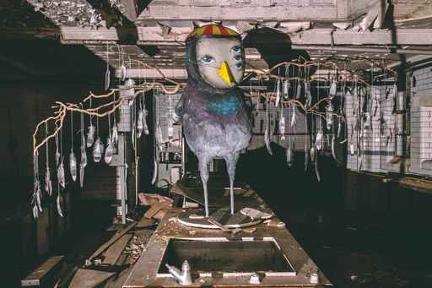
‘Inside’
What is an immersive street art installation?
Notes:
Much of My Dog Sighs’ work until now has been outdoors – as a street artist a lot of it is on walls and sides of buildings. But he has been working on a new and exciting art project, the biggest he's ever done, and very different from his usual work. It will be open to the public in the middle of July. This art project is called 'Inside'.
Can you guess what this project is about? (There is a clue in the name!)
This art project is in fact the whole inside of a building in Portsmouth. This is a change for My Dog Sighs as he is so used to working outside where his art can be viewed by everyone. He has taken over a derelict building and made the whole thing into a work of art.
He’s calling it an immersive street art installation. Does anyone know what that term means? (Immersive means that you’re surrounded by it so you feel completely involved, and art installation is a term for a type of 3-dimensional art that takes over a whole space, in this case combining it with the genre of street art. The whole of the building is the art installation.)
My Dog Sighs had been feeling for a few years that he wanted to bring a street art show indoors where he could control the environment but still make it feel ‘street’. He scoped out a number of abandoned buildings across Portsmouth but none of them had quite what he was looking for. However everything clicked when he found this building that had been derelict for 30 years. The owner was incredible giving him the building for 18 months to do what he chose with it. First he had to make it watertight, then evict 300 pigeons, get specialist companies to clear the aftermath and make it safe while still keeping the aesthetics of an abandoned building.

Slide 6
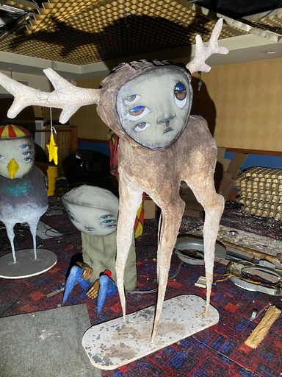
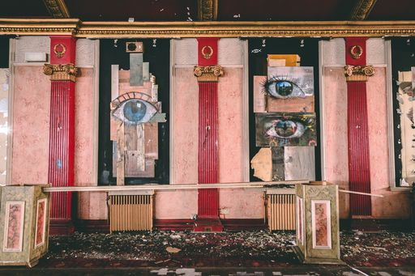
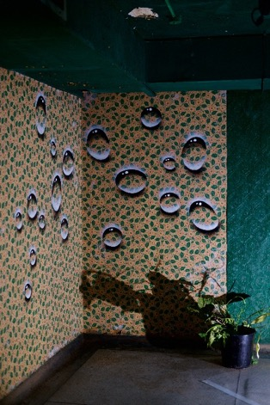
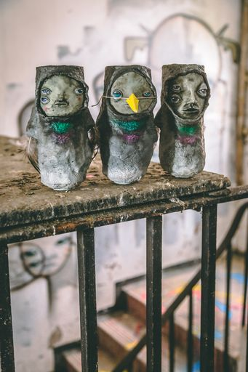
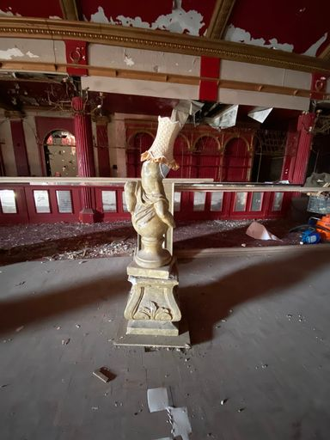
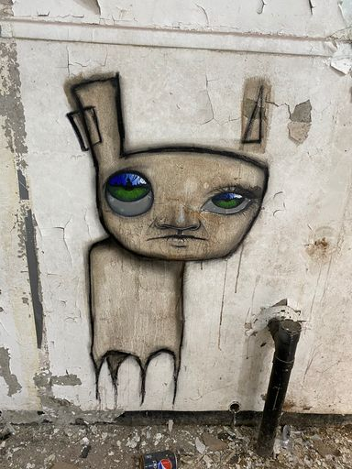
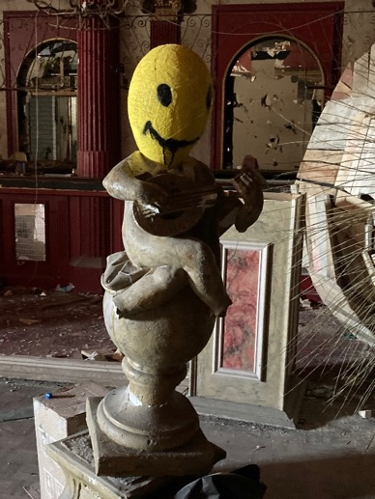
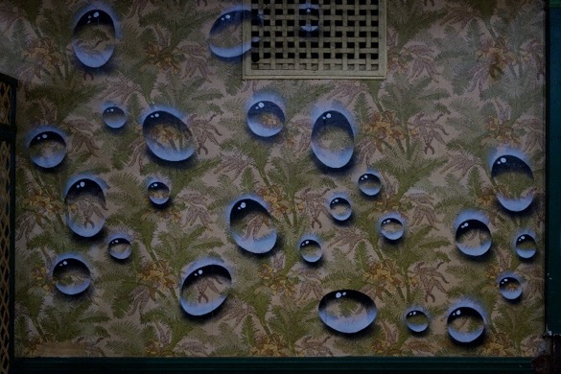
Notes:
This art installation tells a story of a world inhabited by My Dog Sigh’s own anthropomorphic creatures, which he's called his ‘Quiet Little Voices’. What is an anthropomorphic creature? (Anthropomorphic means having human characteristics.)
You'll find these strange creatures in every nook and cranny of the building, finding shelter, creating their own language and making artwork. You'll see them as paintings on walls, or painted tin cans hidden away, or sculptures made out of all sorts of things, both tiny and enormous. All of them have been created by My Dog Sighs.
My Dog Sighs has used the derelict building itself as inspiration, finding beauty amongst its dilapidated floors and crumbling walls.
What examples can you see of how he has used the building or things that he found within the building as inspiration for his work? (painting bubbles on the old wallpaper, giving them a 3-D effect; finding pigeons nesting in the eaves, using them as the inspiration for some of his creatures; making existing statues into his own sculptures.
He has worked closely with both sound experts and a creative lighting company to make it even more of an ‘immersive’ experience as people walk through this art installation.
If time, watch 3 minute video of My Dog Sighs at work on his art project Inside with some images of the building. https://vimeo.com/566575238 password mds As a focus ask them to make a note of 5 different methods that he uses to create the work. (painting (wooden hands),spraying (on walls), fingerpainting, delicate painting eyes on walls with a thin brush, sculpture (one of his Quiet Little Voices with raincloud).

Slide 7
Activity 1: plan a piece of installation art – a creature that inhabits the room
While watching My Dog Sighs taking you round the kitchen create a spider diagram of words and items that come to mind for the creature
kitchen
smells
sounds
textures
items
feelings
Notes:
Activity 1
The task is to plan a piece of installation art – a creature that inhabits a derelict room which reflects something about the room – whether it’s the feelings that you get in the room, objects that have been found in the room or a memory to the history of the room.
My Dog Sighs is going to take us on a virtual journey through the kitchen of his derelict building. As you watch, start to create a spider diagram on your paper, noting down any words and ideas that come to mind for creating your creature – it may be feelings you get, smells, sounds, textures that you see or imagine. Or items that you could use to create your creature…You will be using these notes to help you in your task afterwards.

Slide 8
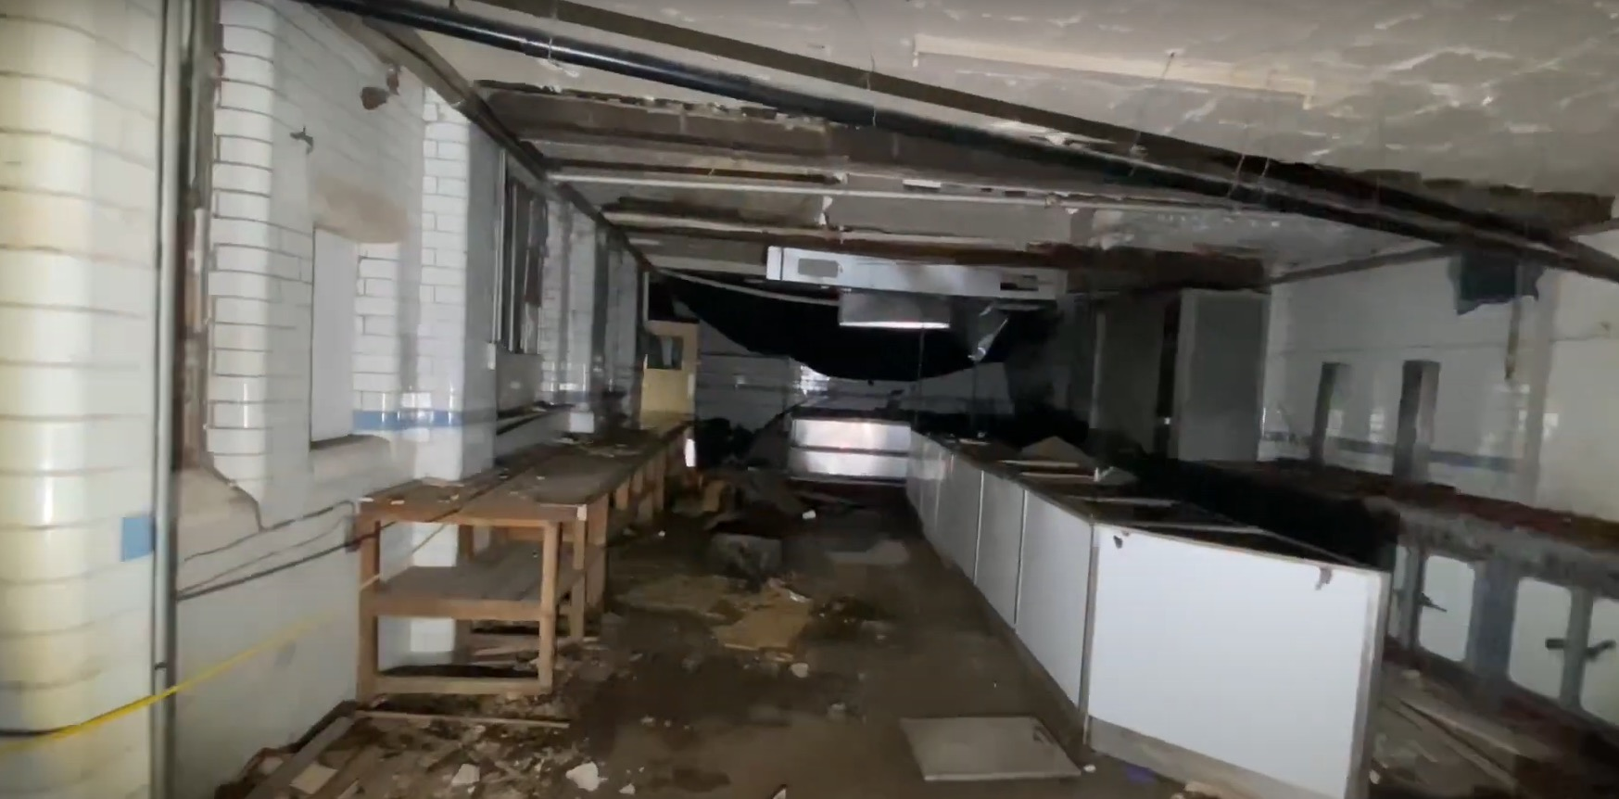
Link to walkthrough video
Notes:
Click on the link on the slide or here https://www.youtube.com/watch?v=IMRO5ZJ17x0 to watch the video.

Slide 9
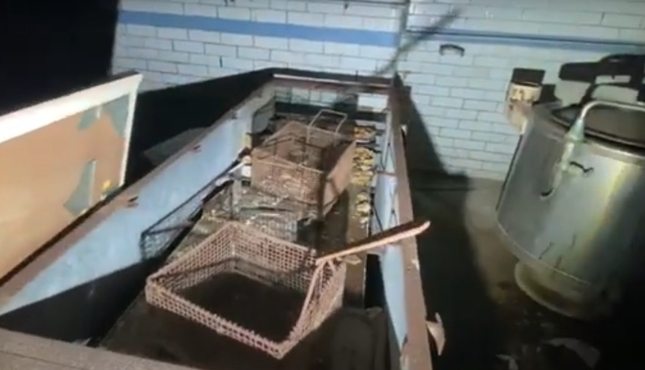
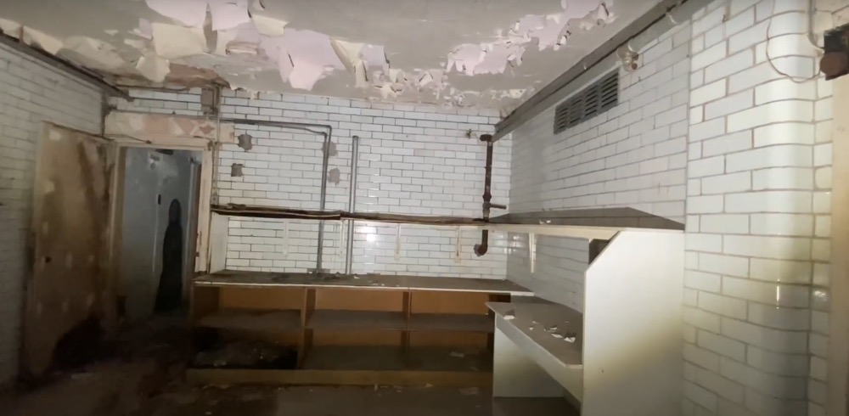
Design a creature as an art installation
Design a creature as an art installation that lives in the derelict kitchen
How will it reflect the atmosphere?
Add notes about colour, texture, sounds etc of your piece of installation art
[Photo of the room MDS took them through.]
Notes:
Using the notes that you have made on your spider diagram, the task is to design a creature as an art installation that reflects your feelings having been walked through the abandoned room by My Dog Sighs. Perhaps it’s something that you feel would sit well within the room to reflect its atmosphere.
Will it use some of the objects that are already in the room? Is it inspired by patterns and textures in the room?
Make notes about colours, textures, size etc to really bring it to life.

Slide 10
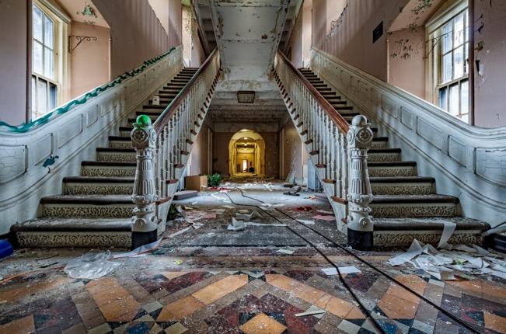
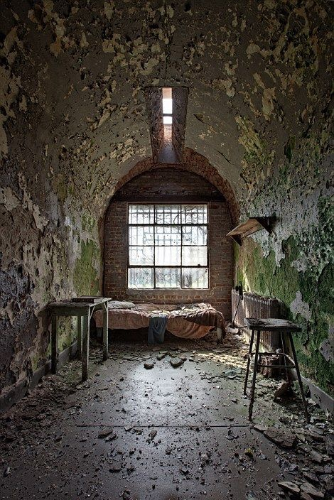
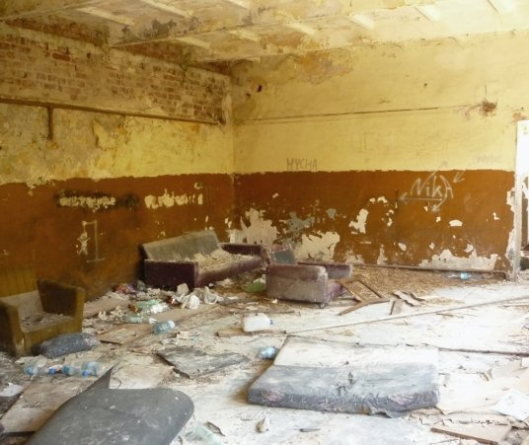
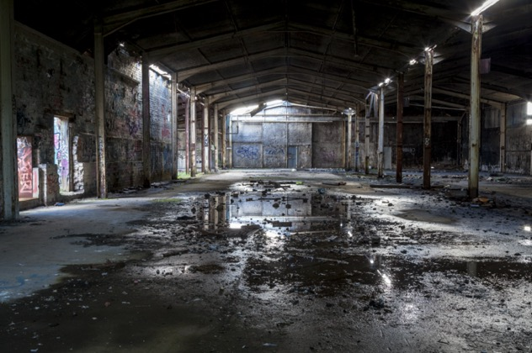
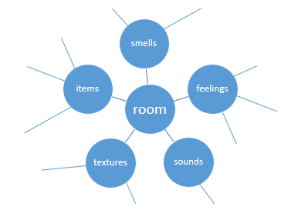
Activity 2: Derelict room
What words come to mind in your derelict room?
Notes:
Activity 2
Here are some pictures of rooms within derelict buildings. Decide which one you want to imagine you’re in or think of a room of your own choice, and as I ask you questions about them I’d like you to imagine yourself there and create a spider diagram of words that come to mind on your paper – it may be feelings you get, smells, sounds, textures that you imagine. Or objects/creatures that you could imagine being there…
Start asking them questions so that they can really imagine being in their chosen room…
What does it smell like?
Can you hear anything as you walk through it?
What buildings do you think they are?
What can you say about the texture on the walls and the floor?
Are there any objects or creatures in it?

Slide 11
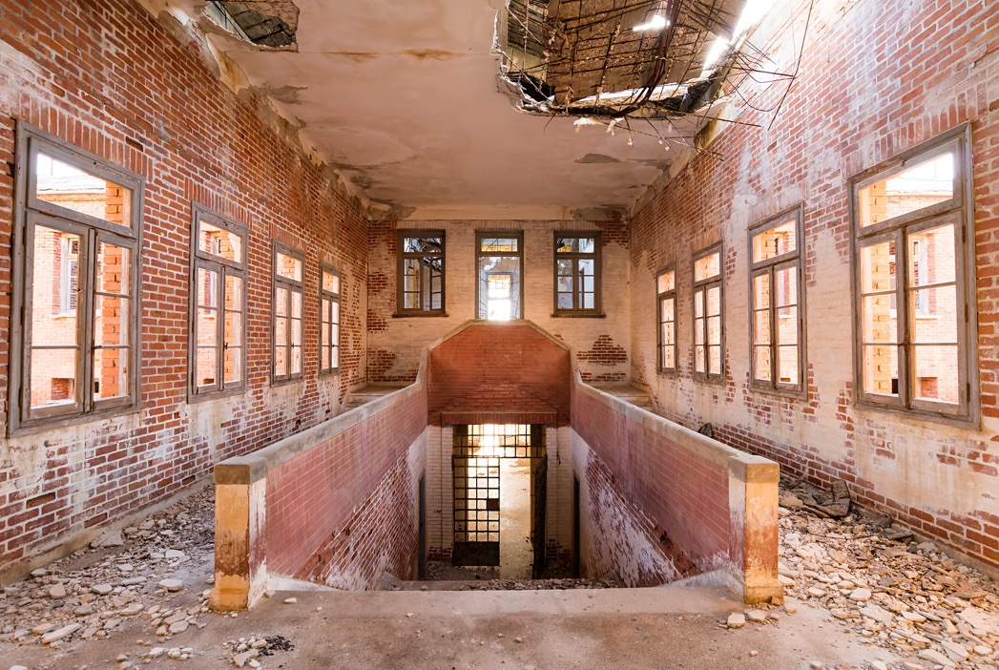
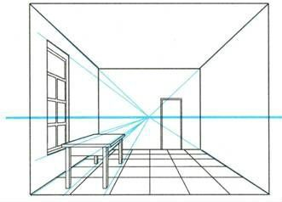
Design a room as an art installation
Using one-point perspective, sketch a room within a derelict building.
Sketch and note how you will make it into an art installation. Will there be a central object? Will the room itself be the installation?
Add notes about colour, texture, sounds etc.
One-point perspective
Notes:
Using the notes that you have made on your spider diagram, the task is to sketch a derelict room that you are going to make into a piece of installation art.
Decide on the type of room you are going to draw. Will it be a church, a kitchen, an entrance hall with sweeping stairs?
Using the one point perspective rule sketch the layout and the detail of the room. Then add details and make notes to show how it will look as an art installation. Will there be a central object – perhaps inspired by something relevant to the room? Or will you decorate the whole room to make it a piece of art?
Add notes about colour, texture, the light coming through the windows, sounds, atmosphere etc.

Slide 12
Activity 3: Paint / draw 3D-looking bubbles
Notes:
Activity 3
We’re going to learn and have a go at a technique to create 3D-looking bubbles that you’ll see throughout My Dog Sighs’ artwork and that he has painted on many of the walls of his art installation Inside.

Slide 13
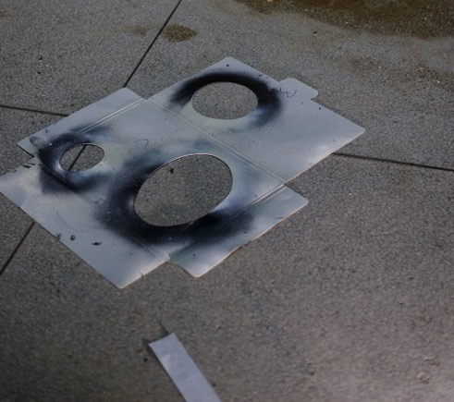
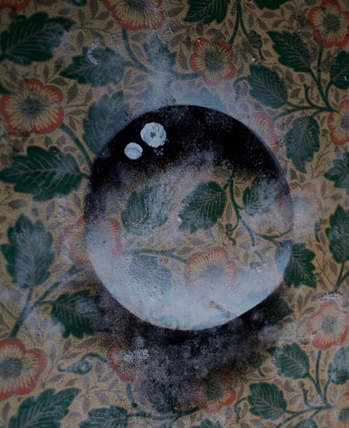
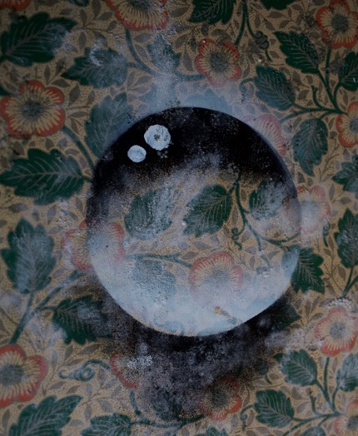
1
2
3
4
5
Notes:
You need a piece of patterned paper (wall paper, wrapping paper, magazine, newspaper, music paper), a piece of card, and black and white (or light blue/grey) paint or pastels.
Cut 3 or 4 round and oval shapes out of the card – keeping the outside of the shapes as well as the insides. You will need both.
Starting with the inside of one of the shapes, place it on your patterned paper, and paint or colour around the top of the stencil in white and then the bottom in black.
Next take the outside stencil of the same shape and place it exactly in the same spot and this time paint or colour inside the shape – black at the top and white at the bottom.
Finish it off by adding a couple of white blobs for the highlights…and there you have your bubble!

Slide 14
Take away activity
Notes:
(If local) Tell them about dates and location of Inside The art installation Inside that we learnt about earlier is taking place in Portsmouth from Friday 16th July to Sunday 1st August 2021. If you’re interested in seeing more of the amazing art that My Dog Sighs has been doing you can find all the details on the back of the take away sheet
Either as an activity if they finish early or to do at home – do some more research on My Dog Sighs. There is an inspiring 15 minute Ted talk, and another talk on YouTube about Inside. Give out 2-sided take away worksheet to take home with further details of My Dog Sighs and Inside.

