Slide 1
Key Stage 3

Slide 2
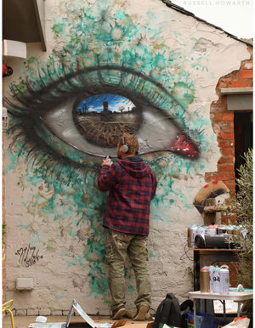
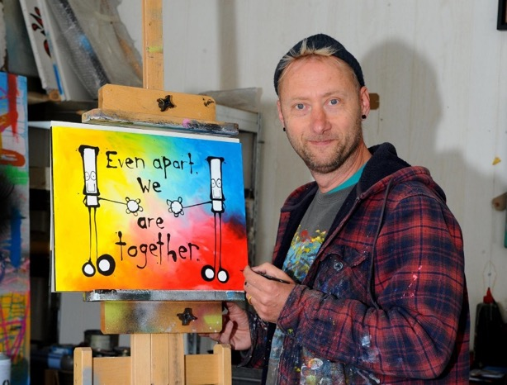
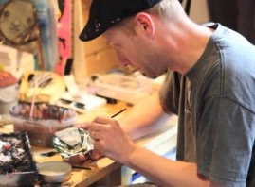
Portsmouth based street artist, My Dog Sighs.
What is street art?
He has been a practising artist for 20 years.
He is internationally known, holding exhibitions around the world including USA, Israel and Australia
Notes:
We’re going to be finding out about a street artist based in Portsmouth called My Dog Sighs.
What is a street artist or street art? (It is art that is created in a public space, often on walls. It’s often used to make people think about something.)
My Dog Sighs has been a full-time artist for 20 years. He is well known internationally, holding exhibitions and displaying art in countries including USA, Israel and Australia.
However it wasn’t always like that…He was originally a teacher but his dream was always to be an artist. To start with he thought that to become a full-time artist he would need to paint the kinds of pictures you see in art galleries. However art galleries weren’t interested in the paintings that he took to them. My Dog Sighs realised that he wasn’t actually creating art that interested him; he had been painting what he thought would make him an artist.

Slide 3
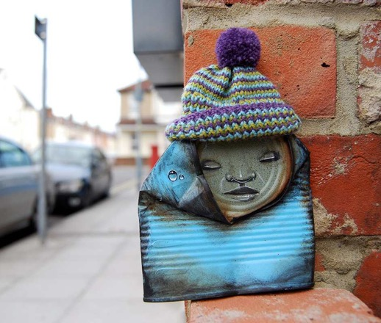
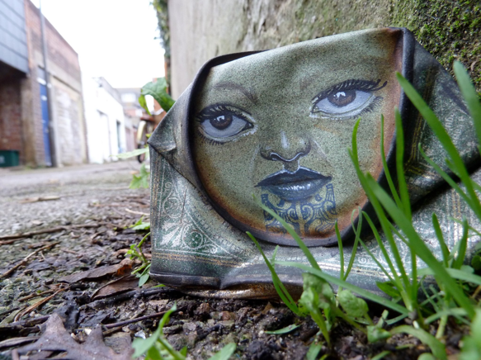
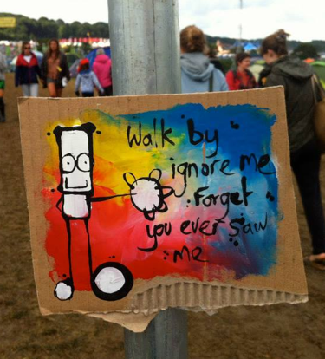
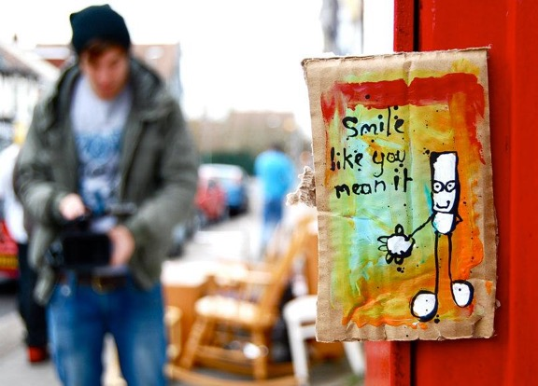
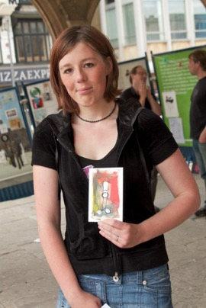
Free Art Friday
Look at the pictures –
what do you think
Free Art Friday is?
Notes:
So he carried on being a teacher and just doing art as a hobby, creating the kinds of things that interested him rather than what he thought others wanted.
However, everything changed about 10 years ago because of a project that My Dog Sighs started called Free Art Friday.
Looking at the pictures, can you guess what Free Art Friday is?
He started leaving a piece of his art somewhere in Portsmouth every Friday. He would leave a little tag on it saying ‘Free art. I’m yours. Take me home.’ Here you can see the types of art he would leave and photos of people who found some of his art.
Free Art Friday now happens all round the world with people leaving pieces of their art for others to pick up. Remember art doesn't have to just be something painted on paper, it could be anything that someone has created.​
What would you think if you stumbled across a piece of art like this?
(If you have a spare few minutes you might like to play the short video ‘A can is born’ https://vimeo.com/42646240. As the whole video is 10 minutes you may like to use the forward arrow to move forward at a faster pace.)

Slide 4
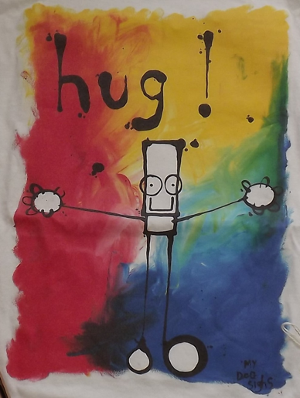
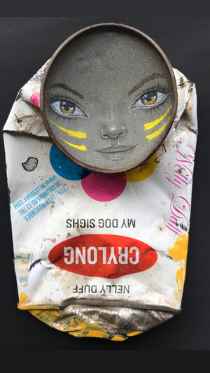
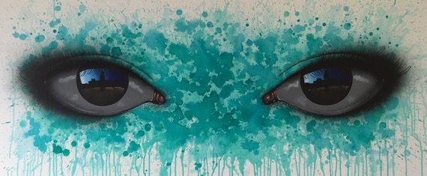
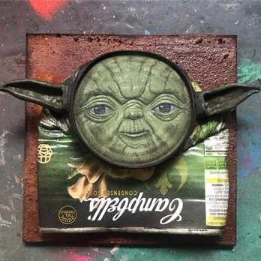
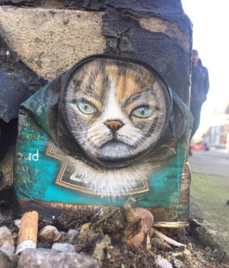
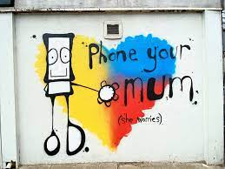
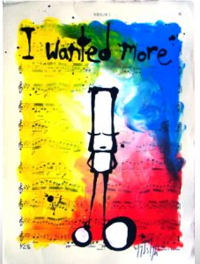
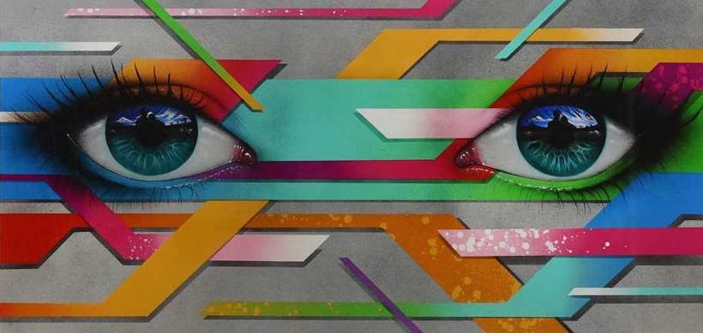
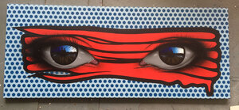
Spot 3 themes
Notes:
From getting well-known for Free Art Friday, it went crazy from there. He quickly went part time in his teaching job then gave in his notice and started painting full time. HIs feet haven’t hit the ground since. My Dog Sighs is best known for 3 particular styles.
Look closely at this slide; can you spot 3 themes?
The black and white character on the colourful background he calls Everyman. He often includes words from songs with it.
He creates characters with life-like faces out of found objects, for example crushed tins.
He’s well-known for his hyper-realistic eyes. (Hyper-realistic means that they look real but in an unusual or striking way.) What do you notice when you look closely at these eyes? (In the shiny surface of the eyeball he has painted a reflection of an image – it may be people, places or stories.)

Slide 5
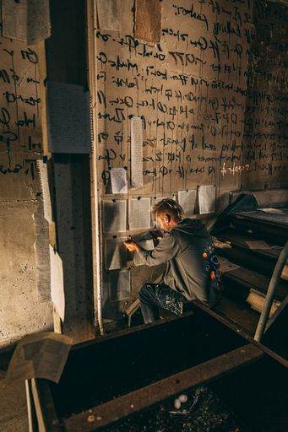
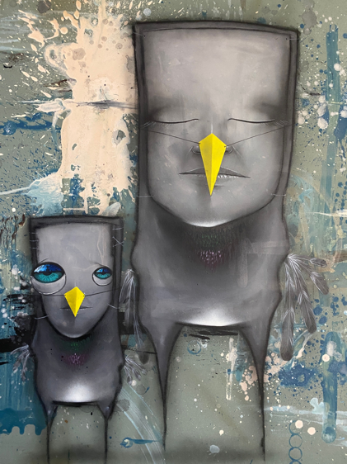
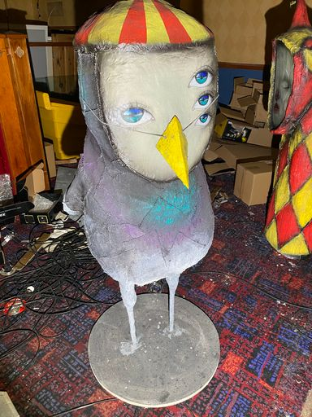
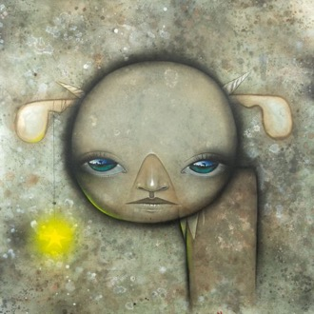
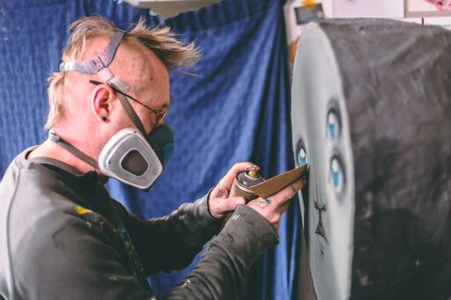
Art project ‘Inside’
What do you think
Inside is?
Notes:
Much of My Dog Sighs’ work until now has been outdoors – as a street artist a lot of it is on walls and sides of buildings. But he has been working on a new and exciting art project, the biggest he's ever done, and very different from his usual work. It will be open to the public in the middle of July. This art project is called 'Inside'.
Can you guess what this project is about? (There is a clue in the name!)
This art project is in fact the whole inside of a building. This is a change for My Dog Sighs as he is so used to working outside where his art can be viewed by everyone. My Dog Sighs has taken over a derelict building. What is a derelict building? (A building that hasn't been used for a long time).
This project tells a story of a world inhabited by My Dog Sigh’s own creatures, which he's called his ‘Quiet Little Voices’. You'll find these strange creatures in every nook and cranny of the building, finding shelter, creating their own language and making artwork. You'll see them as paintings on walls, or painted tin cans hidden away, or sculptures made out of all sorts of things. All of them have been created by My Dog Sighs.
If time, watch 3 minute video of My Dog Sighs at work on his art project Inside with some images of the building. https://vimeo.com/566575238 password mds As a focus ask them to make a note of 6 different things he creates (Strange writing on the walls, painting a wooden hand (this belongs to an artist’s model), face with eyes, picture with fingerpaints, delicate eyes on walls, big wooden igloo, woven ‘thing’ with face, sculpture of one of his Quiet Little Voices with a raincloud over it.)

Slide 6
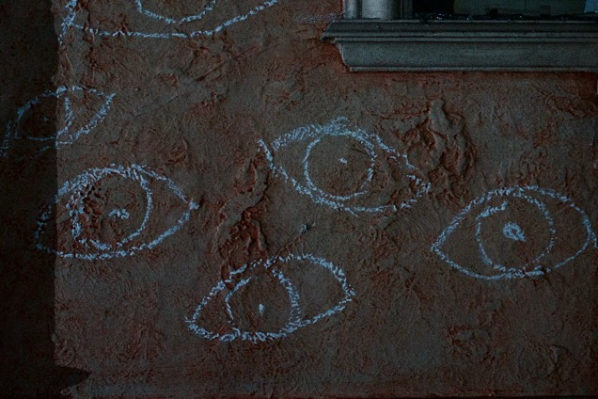
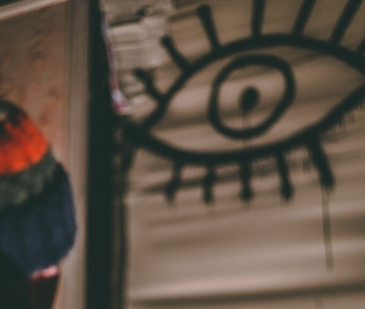
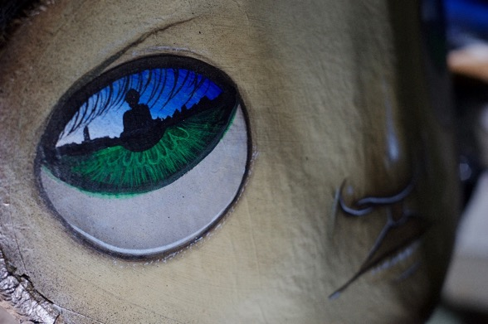
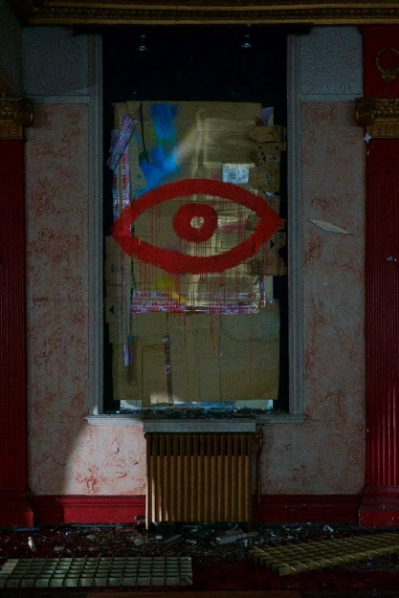
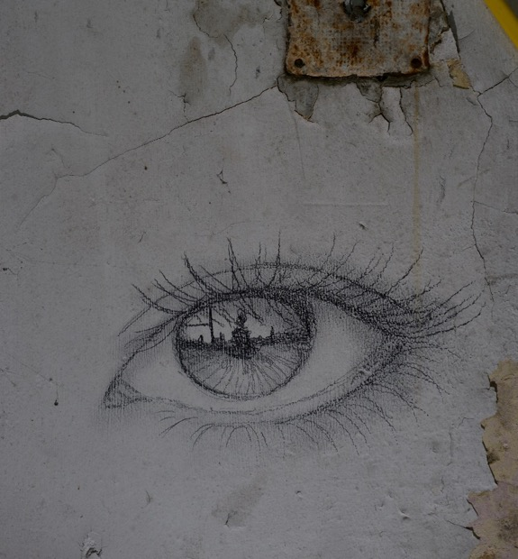
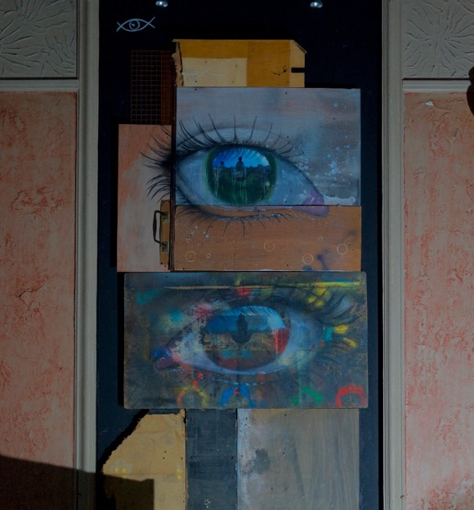
Notes:
My Dog Sighs’ art event also features lots of eyes. Eyes on the wall, eyes on his 3D characters, eyes on canvas.
What do you notice when you look at these pictures of eyes that you’ll find inside the building? (As a clue suggest that they compare them moving from left to right on the slide.)
The eyes featured in his art event show how his skills as have developed. These pictures remind us that he would have started by drawing very simplistic eye sketches and gradually developed his skills and style to move into the hyper-realistic eyes that he is known for.
Can you remember how you drew eyes when you were a young child? (perhaps just dots or circles.)
So we’re going to be focussing on eyes today.

Slide 7
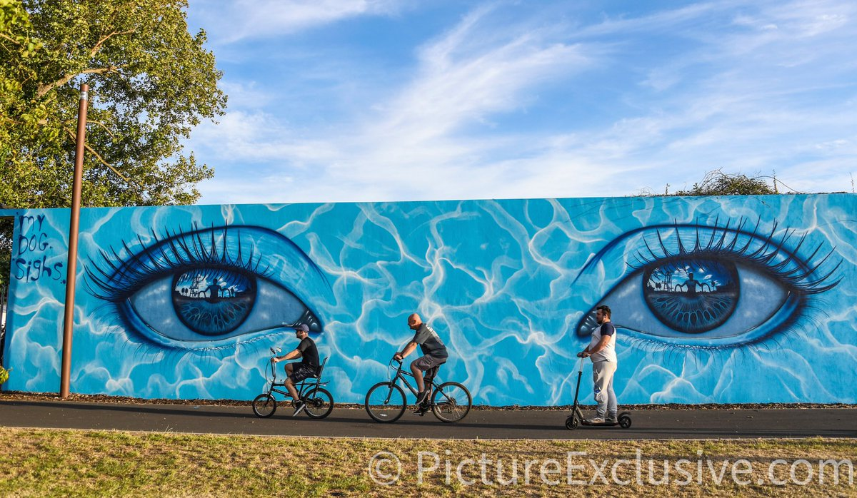
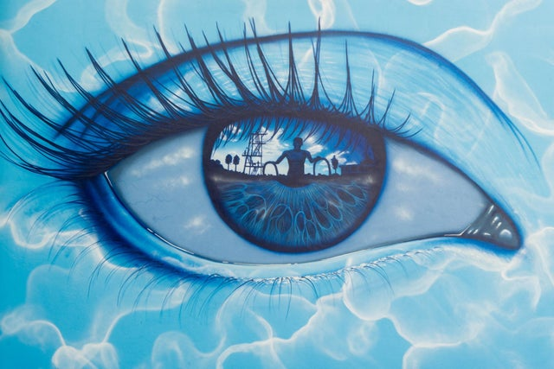
Hilsea Lido in Portsmouth
What do you see in the eye?
Notes:
As you can see here, he has painted an eye design on the wall of a lido. (A lido is an outdoor swimming pool.)
What do you see in the eye? (Someone getting out of a pool – in fact it is a famous actor called Sean Connery who used to visit the pool when he was in the area!)
Can you see what else he has done to make it fit the theme of a swimming pool? (water/wave patterns around the eyes.)

Slide 8
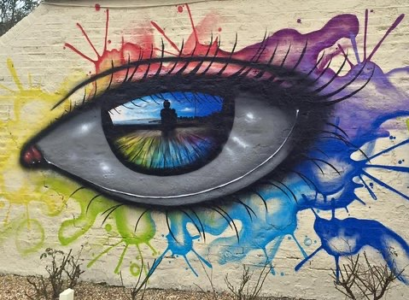
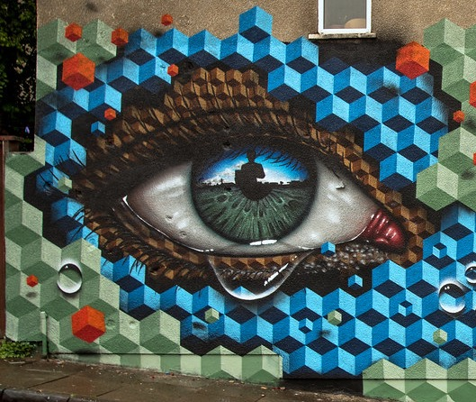
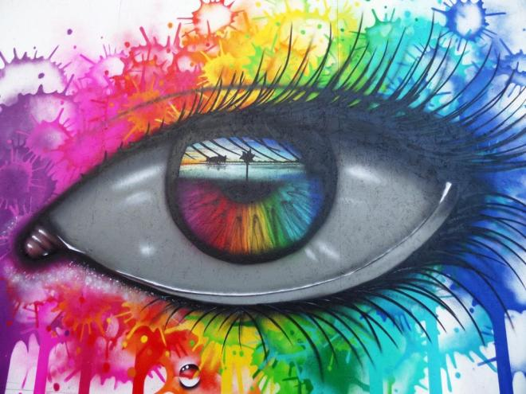
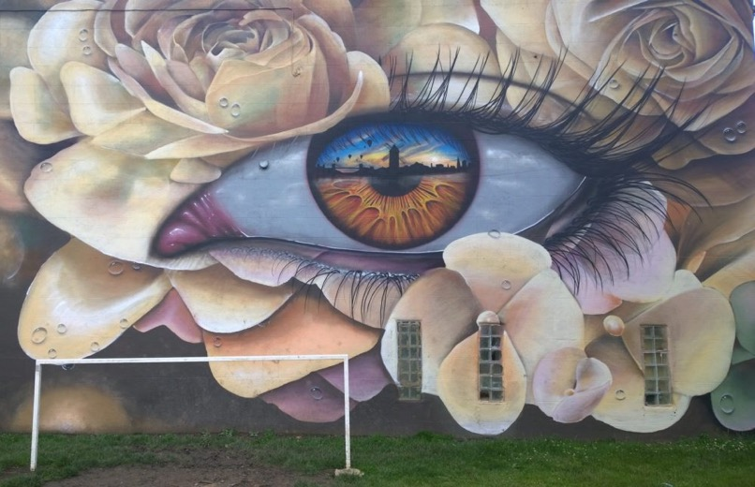
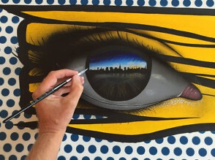
Notes:
My Dog Sighs’ uses the shiny surface of the eyeball to reflect images. These images are reflections of the world around them.
They might be people, places or stories. So the viewer is seeing what the eye is looking at. What scenes can you see in these eyes?
What do you notice about the use of the colours within the eyes? (Sometimes they reflect the outside colours, some of them represent a place, a feeling or an atmosphere.)
Discuss how colours can be used to convey emotions, and give examples with different colours.
What different styles do you see in the artwork around the eyes? (Gentle ‘blobs’, blended rainbow stripes, harsh geometric lines, geometric 3D cube shapes, realistic flowers.)
Discuss how different styles of mark-making can also convey emotions, feelings and atmosphere.
So colour and mark-making are both important in My Dog Sighs’ work.
Some of My Dog Sighs’ paintings are collaborations so he will work with another artist who will paint the pattern or detail around the eye.

Slide 9
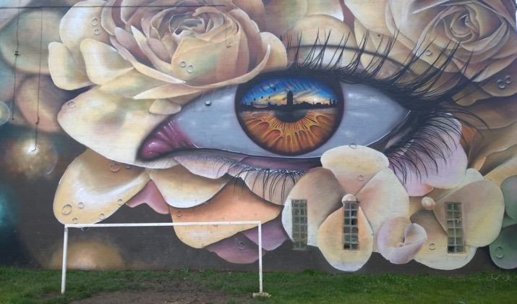
Activity 1: In the style of My Dog Sighs
Consider what to draw in the middle of the eye – the reflection - that reflects an aspect of your life, an event, your surroundings. Something personal to you.
hobbies
person/people
emotions
narrative
place
event
Notes:
Activity 1: The creative task is to complete the middle of an eye in the style of My Dog Sighs.
Think about what the reflection in the middle of the eye could be.
It could be anything that reflects an aspect of your life, an event, your surroundings, a place.
Discuss with a partner using the words on this slide what you might draw in the middle of the eye as the reflection. What emotions or atmosphere will you convey? What colours might you use?

Slide 10
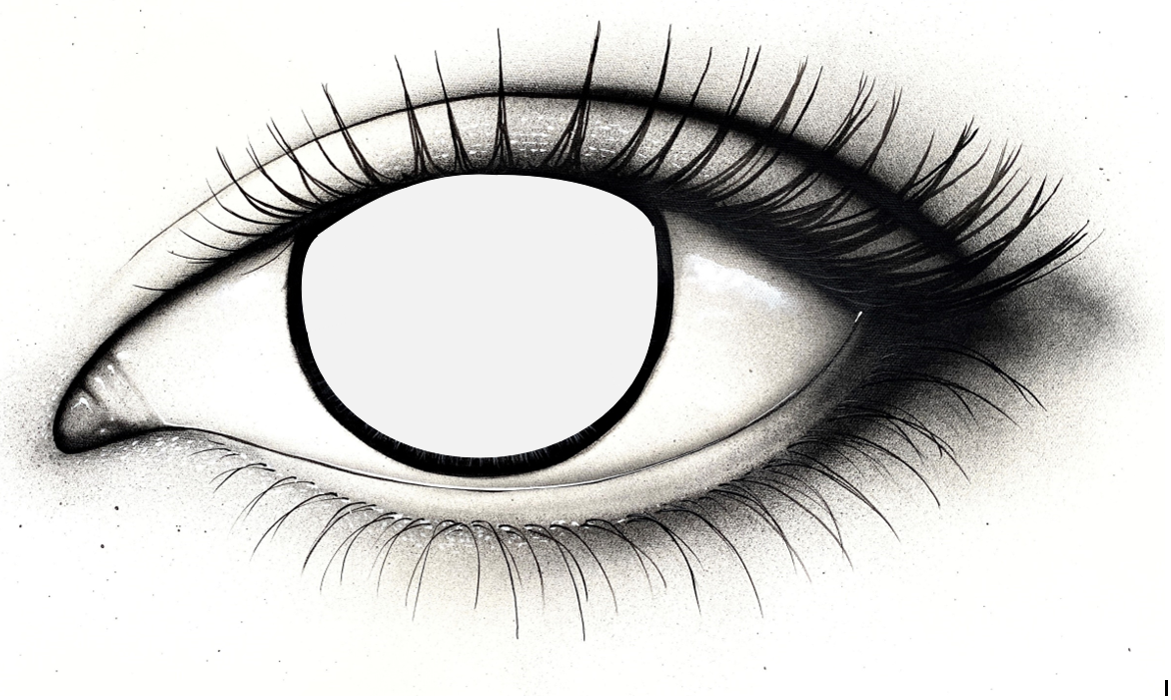
In the style of My Dog Sighs
Complete the middle of the eye to represent an aspect of your life, an event or a place
Think about:
Colour
Mark-making
Notes:
Using this template eye created by My Dog Sighs your task is to complete the middle.
Remember to think carefully about what scene you’re going to create and the colours and mark-making to represent what you are trying to convey. Remind them of earlier discussion of colours and mark-making to represent emotions and moods if needed.
(If they have time, or for a follow-on lesson, they could go on to decorate around the eye, again thinking of colour and mark-making to convey the mood or feeling.)

Slide 11
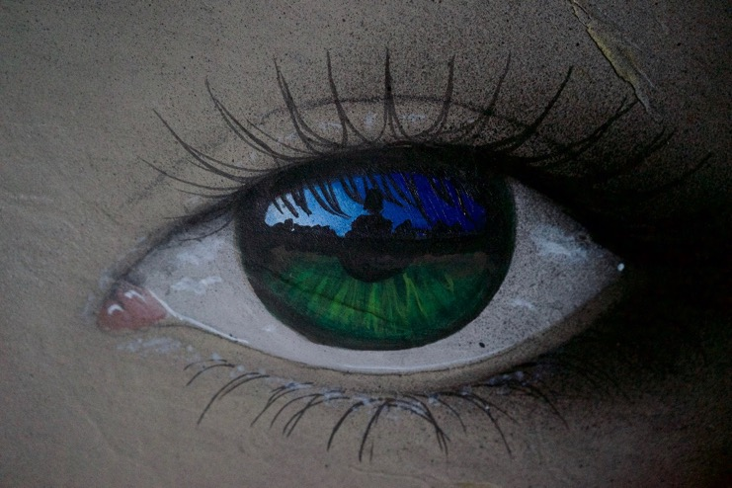
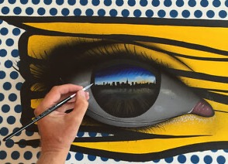
Here are some ideas featuring creative reflections in the middle of the eye to inspire you as you work.
Notes:
You could leave this slide up as inspiration as they get on with their work.

Slide 12
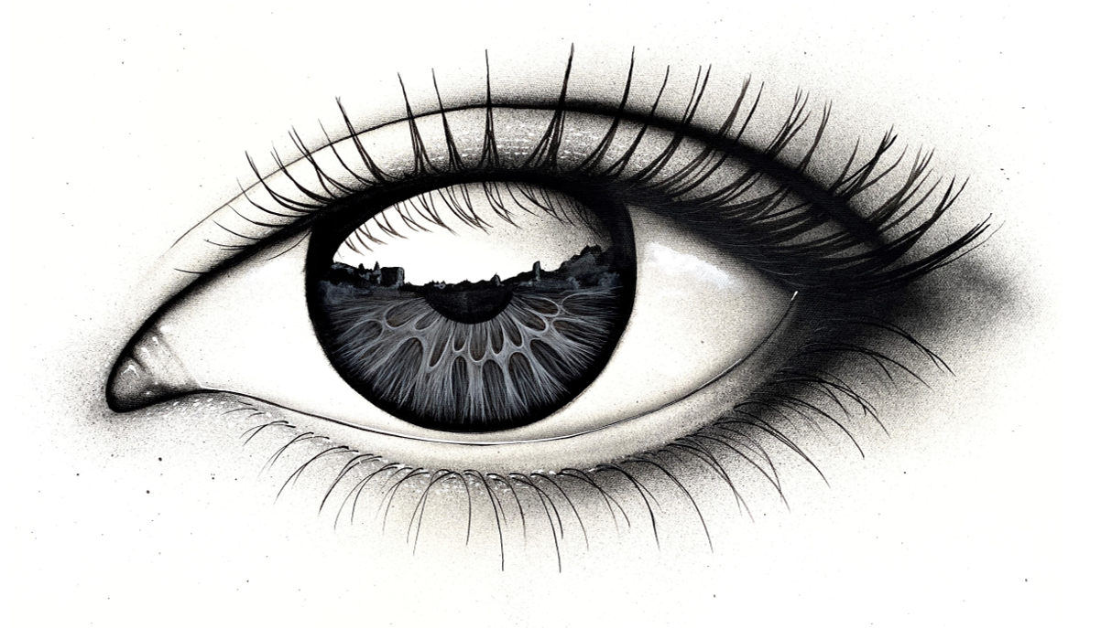
Activity 2: Add a mood to My Dog Sighs’ eye
Look closely at the scene in the eye ball. What mood or emotions do you want to portray?
excited
happy
anxious
mischievous
energetic
adventurous
lonely
quiet
calm
fun
peaceful
hopeful
joyful
Notes:
Activity 2
The task today is to decorate a black and white eye painted by My Dog Sighs.
Have a close look at the centre of this eye. It is a scene of houses and buildings.
What mood or emotions do you want your eye to portray?
Write down some words to describe these.
Click to reveal ideas of words.

Slide 13
In the style of My Dog Sighs
Complete the middle of the eye and then decorate around the eye to convey the mood or emotions you have chosen.
Think about:
Colour
Mark-making
Notes:
Give out Worksheet B.
Thinking about the word(s) you have chosen, colour the middle of the eye and then decorate around the eye using colours and mark-making to represent what you are trying to convey. They could add a black silhouette figure in it if they want to include a person in the scene. Remind them of earlier discussion of colours and mark-making to represent emotions and moods if needed.

Slide 14
Notes:
You could leave this slide up as inspiration for colours and design.

Slide 15
Activity 3: Think about your eye-dentity.
Reflect on your world.
Which words relate to you, your life, your personality?
excited
anxious
happy
mischievous
energetic
adventurous
annoyed
lonely
quiet
calm
fun
peaceful
hopeful
joyful
Notes:
Activity 3
The task today is to personalise an eye in your own style.
Start by thinking of some words that describe YOU or YOUR INTERESTS in order to personalise the eye and write them down.
Click to reveal words if they need help.
Here are some examples of words but you are welcome to think of your own!

Slide 16
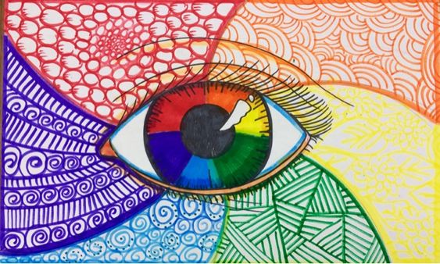
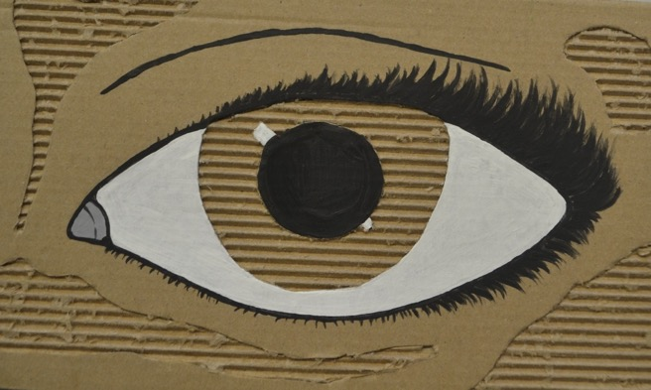
Create a visual (a response to My Dog Sighs’ eye)
Using the template of the eye (or draw from scratch if you’re brave!) personalise an eye drawing!
Think about the colours you use (what do they symbolise?). Think about pattern and mark making.
Notes:
Think about the colours they use and mark making. Remind them of earlier discussion of colours and mark-making to represent emotions and moods if needed.
You may like to add words, pictures or patterns that reflect you, who you are, your identity.

Slide 17
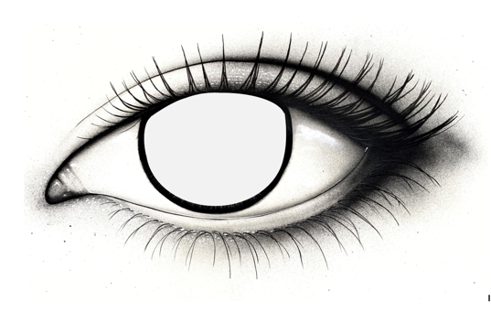
What could you do to this eye to personalise it and make it creative?
No two eyes in the world are the same.
Eyes can show sadness, happiness, worry, calm.
Think about the words you chose.
How could you add them creatively to the eye drawing to reflect YOU and who YOU are.
And what design, pattern or colours would you add to the area around the eye?
Notes:
Using the template (worksheet A) or starting from scratch, ask the class to think about they will personalise their eye in their own style.
They can be as creative as they like, to try and reflect who they are or an event in their life.

Slide 18
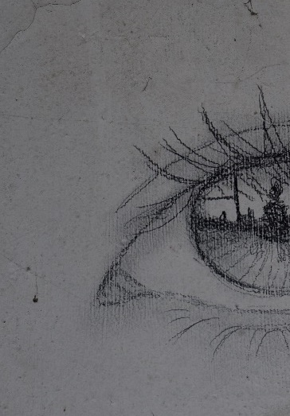
Activity 4: Complete the eye
Draw the other half of this eye, drawn by My Dog Sighs in his project Inside.
Notes:
Activity 4
Using worksheet C and a pencil, complete the other half of the eye drawn by My Dog Sighs as part of his project Inside.
Either look at their own eyes in a mirror or study someone else’s eyes or find an eye in a magazine. Alternatively show slide 15 for them to copy. Look at the shape of the other half of the eye, the eye lashes.

Slide 19
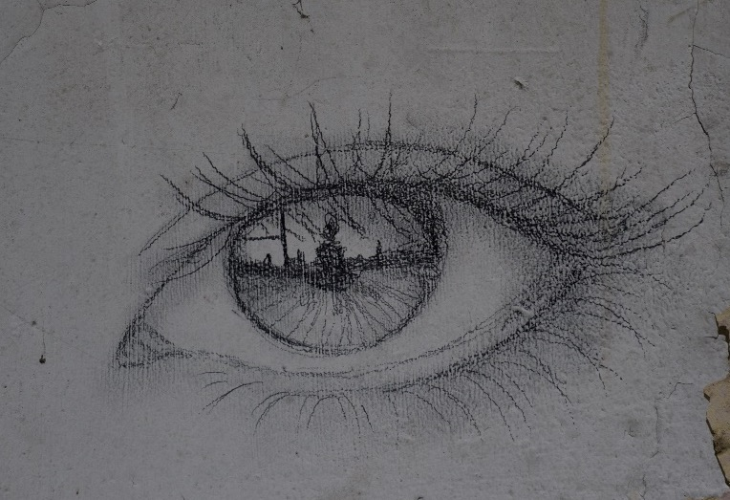
Notes:
The complete picture of the eye.

Slide 20
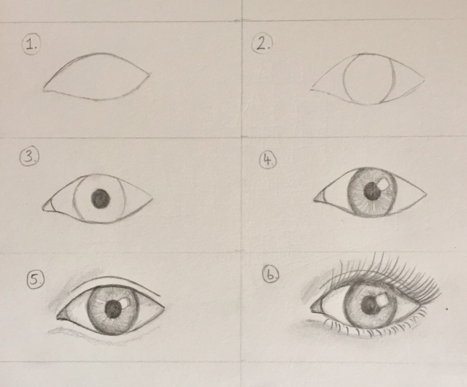
Take away activity
Improve your drawing skills and get confident at drawing a realistic eye, following the step-by-step guide.
Notes:
The art installation Inside that we learnt about earlier is taking place in Portsmouth from Friday 16th July to Sunday 1st August 2021. If you’re interested in seeing more of the amazing art that My Dog Sighs has been doing, meet his Quiet Little Voices and see lots of his Eyes for yourself you can find all the details on the back of the take away activity sheet.
Take away activity – print out the double-sided worksheet (cut in half) for them to take home and practise drawing a realistic eye. On the back is further information about My Dog Sighs and his project Inside.

