Slide 1
My Dog Sighs
Key Stage 1
Key Stage 2

Slide 2
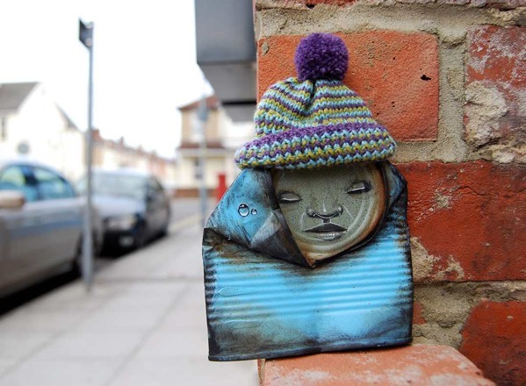
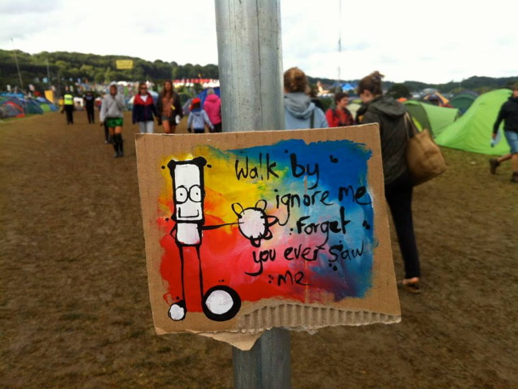
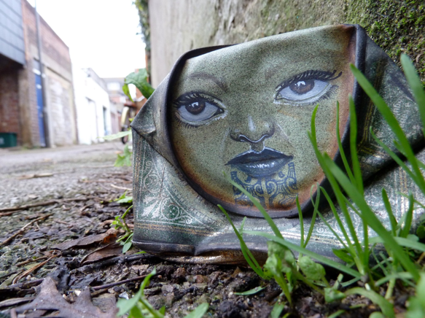
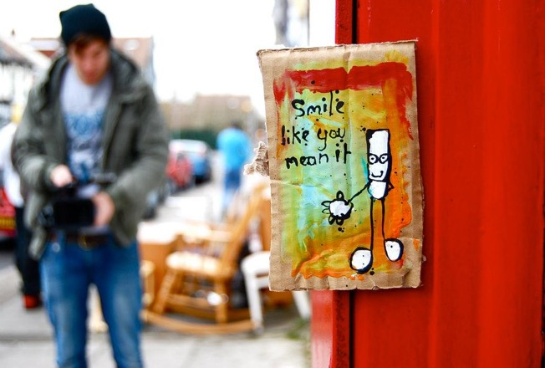
What are they?
How were they made?
How did they get there?
How do they make you feel?
Notes:
Have you ever been walking down the street and stumbled across something like one of these? (Click to reveal questions)
What do you think they are? (2 are paintings on cardboard, 2 are squashed cans painted with a face)
How do you think they were made?
How do you think they got there?
How do they make you feel?

Slide 3
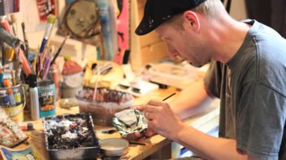
My Dog Sighs
Notes:
They were created by an artist called My Dog Sighs. Funny name hey?!
My Dog Sighs lives in Portsmouth and used to be a teacher.
For many years he wanted to become an artist. To start with he painted pictures like the paintings he saw in art galleries.
What’s an art gallery? (A room where art is displayed.)
But when he took them to the art galleries they weren’t interested in displaying them as there was nothing special about them. My Dog Sighs realised he wasn’t painting things that interested him.

Slide 4
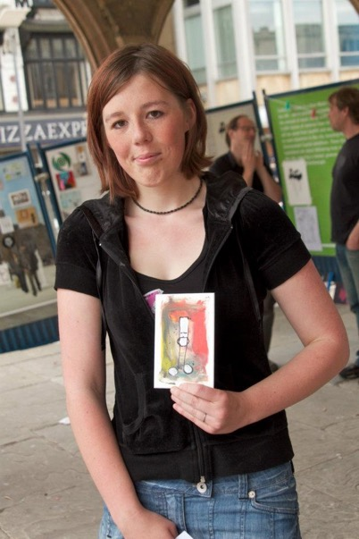
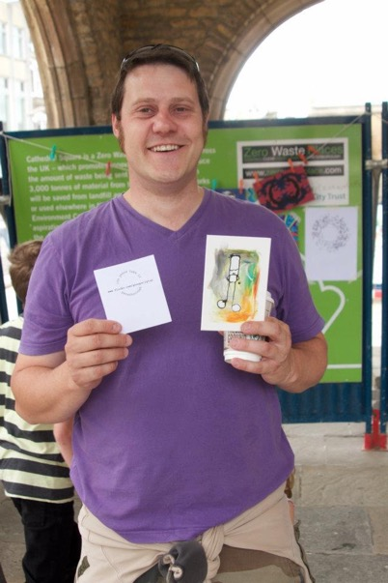
Free Art Friday
Free art, I’m yours. Take me home!
Notes:
So he carried on being a teacher and just doing art as a hobby.
However 10 years ago My Dog Sighs decided to start leaving a piece of art somewhere in Portsmouth every Friday. This time it was the kind of art that he wanted to paint, not the kind that he thought he had to paint. He would leave a little tag on it saying ‘Free art. I’m yours. Take me home.’ Here are some people who found some of his art. Since then Free Art Friday happens in lots of different places all round the world and lots of people leave little pieces of their art for others to pick up. Why not start looking around you on a Friday as you walk down the street in case you stumble across something? Remember art doesn't have to just be something painted on paper, it could be anything that someone has created.

Slide 5
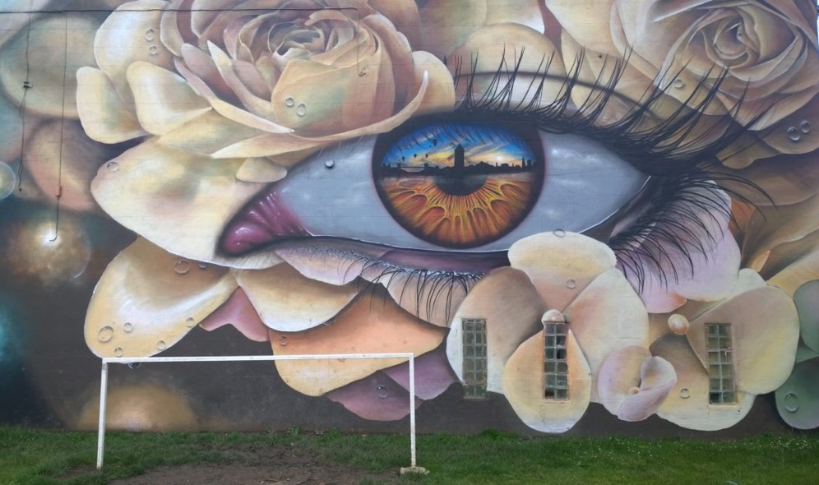
What do you notice?
What similarities and differences do you see?
How does it make you feel?
What do you like or not like about them?
Notes:
Since then My Dog Sighs has become a well-known artist and his creations can be seen around the world.
Not only does he create little pieces of art from cans or on cardboard as you’ve seen, but he has become well known for painting eyes. But eyes with a difference…
These are just two examples. Click to reveal questions.
What do you notice when you look closely at these two pictures of an eye? (In the shiny surface of the eyeball he has painted a reflection of an image – it may be people, places or stories.)
All his eyes are different. What similarities and differences do you see in these two? (The shapes of the eyes are similar, and they both have eye lashes and eyebrows. Differences - colours and design around the eye, reflections in the eyeball – one is a windmill the other is two people.)
Choose one of them – how does it make you feel? (Encourage the to think about the pictures in the eyes, the colours, the designs around the eyes.)
Is there something you particularly like about either of them, or something that you really don’t like?
Some of My Dog Sigh's art is enormous, sometimes as big as a wall.
Any ideas how he paints them so big? What do you think he uses to paint on if they're that big?

Slide 6
Street Art
Have you seen any street art?
What do you like or not like about street art?
Notes:
He is often asked to paint his creations on walls and he uses spray cans of paint. This is known as Street Art.
Have any of you seen street art before?
Have any of you seen any street art that might be created by My Dog Sighs? (See attached map to find out where his art can be seen)
Do you like the idea of street art or not? Why or why not?
What do you think these different people may think of street art – children, teenagers, parents, grandparents? (In pairs, get the children to consider the perspective of one of those groups.)

Slide 7
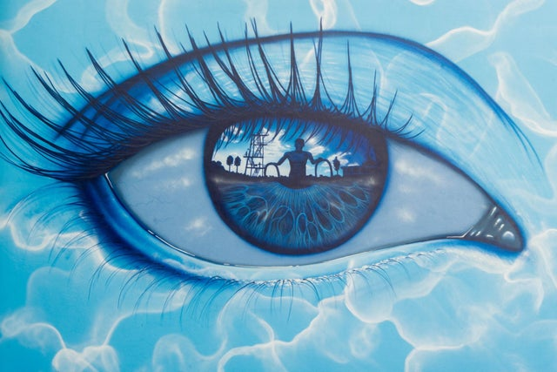
Hilsea Lido
Notes:
(Optional – if you have time)
This is one he was asked to paint at an open air swimming pool known as a lido.
What can you see when you look in the middle of the eye? (Someone getting out of a pool – in fact it is a famous actor called Sean Connery who used to visit the pool when he was in the area!)

Slide 8
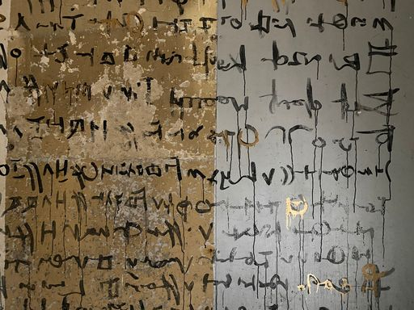
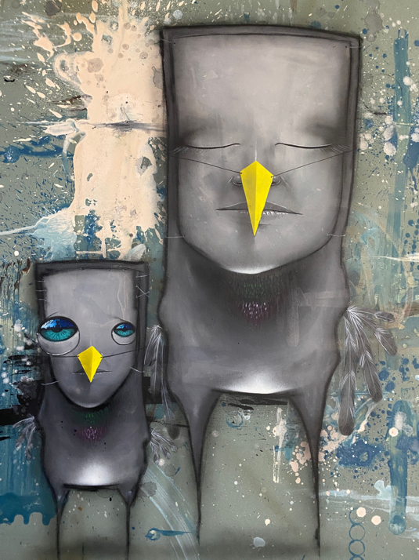
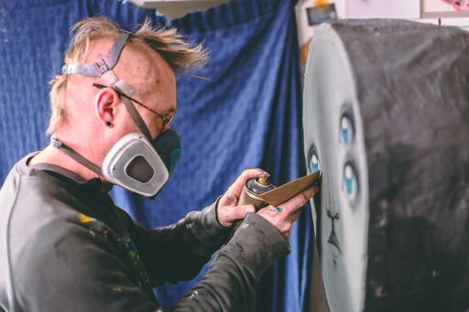
'Inside'
Notes:
My Dog Sighs is working on a new and exciting art project, the biggest he's ever done. This art project is called 'Inside'.
Can anyone guess what this project is about? (There is a clue in the name!)
This art project is in fact the whole inside of a building! My Dog Sighs has taken over a derelict building (in Portsmouth) for his art project.
What do we mean by a derelict building? (A building that hasn't been used for a long time).
This project tells a story of a world inhabited by My Dog Sigh’s own creatures, which he's called his ‘Quiet Little Voices’. Why do you think he calls them his ‘Quiet Little Voices’?
These Quiet Little Voices are different feelings that the artist has. They may be happy, or sad; they may be playful, adventurous, quiet, excited. He says that these Quiet Little Voices help him do his art. Sometimes he feels happy or sad or playful and this shows in the art that he does.
You'll find these strange creatures in every nook and cranny of the building, finding shelter, creating their own language and making artwork. You'll see them as paintings on walls, or painted tin cans hidden away, or sculptures made out of all sorts of things. All of them have been created by My Dog Sighs.
If time, watch 3 minute video of My Dog Sighs at work on his art project Inside with some images of the building. https://vimeo.com/566575238 password mds As a focus ask them to make a note of 6 different things he creates (Strange writing on the walls, painting a wooden hand (this belongs to an artist’s model), face with eyes, picture with fingerpaints, delicate eyes on walls, big wooden igloo, woven ‘thing’ with face, sculpture of one of his Quiet Little Voices with a raincloud over it.)

Slide 9
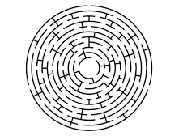
Mind Maze
What is a maze?
Notes:
Part of the building has been made into what My Dog Sighs has called the Mind Maze.
What is a maze – where would you find a maze? Have any of you walked round a maze or done one as a puzzle? (Click to reveal pictures)
What do you think of when we talk about a mind maze? (The idea of your mind being full of different feelings and emotions leading from one to another)
What do you think your mind maze is like? Is it busy / quiet / empty…different at different times?
As people walk through this part of the building it will be like a maze, and at every corner you'll see an image that represents different feelings or emotions or experiences that the artist has had.
What emotions or feelings would sum up your mind at the moment, or sometime this week? Talk to your partner and if you feel comfy, share your feelings with the class. Scribble words on board or move straight to next slide.

Slide 10
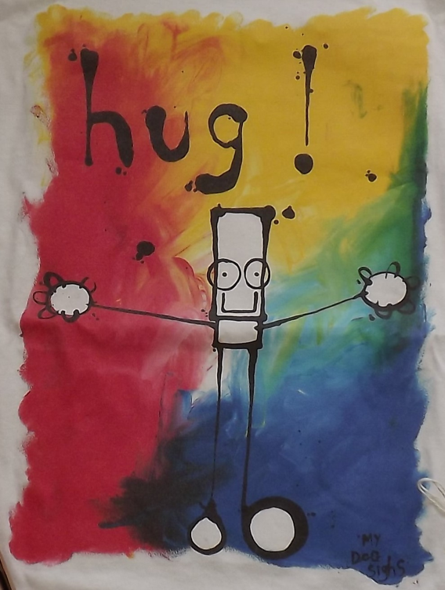
Feelings and emotions
happy
loved
excited
peaceful
surprised
wide awake
annoyed
lonely
angry
anxious
embarrassed
hopeful
Notes:
I'd like you to start thinking about different emotions or feelings that you have had this week, for example perhaps you felt really tired one morning after you'd had a late night. Or perhaps you were going somewhere and you felt excited about it. Or were you nervous about doing something new?
I'm going to give you two minutes to jot down 5 emotions or feelings that you have had at sometime in the week and next to them write why you had those emotions. If you need any ideas, here are some suggestions…(click to reveal a word at a time.)
NB This may be a sensitive subject to some children so invite them to share their ideas if they’re comfy but please be aware that others may feel vulnerable to talk about emotions.

Slide 11
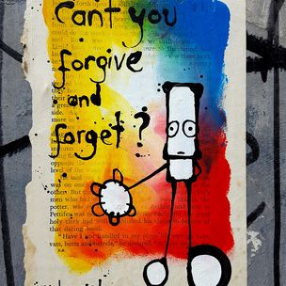
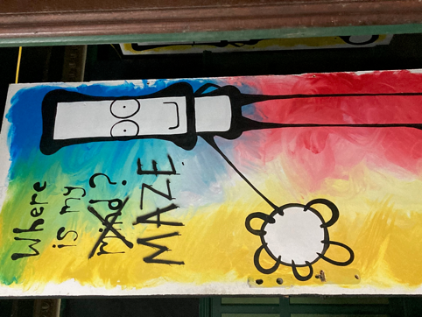
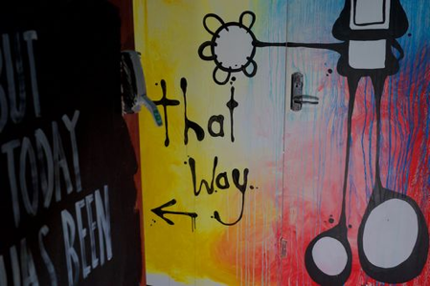
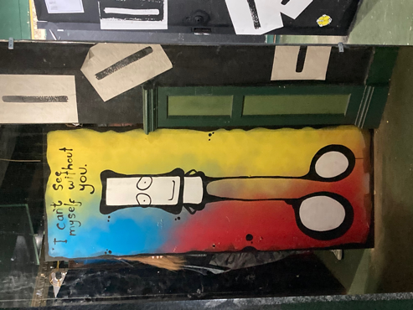
Everyman
Notes:
Have a look at these pictures painted my My Dog Sighs. This is another style that he is well-known for and he calls this character ‘Everyman’. He has used the Everyman character in his mind maze. What do you notice about this style? What is similar with each of them?
The background is made of the primary colours. What are the primary colours? (red, yellow, blue)
There is a white character in front made of circles and rectangles with heavy black outlines.
There’s usually some writing with it – they are often words from a song.
Choose one and have a think about what My Dog Sighs might have been feeling when he painted it. Have a chat to your partner about it and then you can share your ideas.

Slide 12
Activity 1 – make a class mind maze
1
2
3
4
5
6
7
Notes:
Activity1:
We are going to make a mind maze as a class. Each of you will paint an Everyman character for our mind maze. This is the method My Dog Sighs uses to create his Everyman character.
He finger paints the background using the 3 primary colours and white.
He blends the colours together where they meet to make secondary colours. Who can name the 3 secondary colours? (green, orange, purple)
He uses a clean finger to paint a white strip and white blobs for the body and feet and hands on top of the colours. He has to think carefully about where they will be as he will use black for the arms and legs to join them together.
He then uses a thin paintbrush and black paint to draw around the head, body, feet and hands and to join them together
This is what it’ll look like so far.
Then add the features such as eyes, nose and mouth.
Using one of the emotions you chose, create your own Everyman. (Or they can create their own character style to represent the emotion.)
You can then decorate a strip to join to your picture and we’ll use it to make the maze.

Slide 13
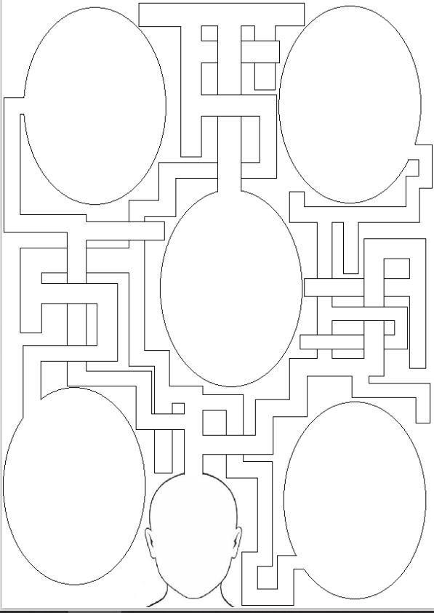
Activity 2: My Mind Maze
Notes:
Activity 2 – My mind maze
We’re going to think about our own mind mazes now.
Thinking back to those 5 emotions you wrote down earlier, use the worksheet (Worksheet A) to draw pictures or words or make collages to represent them in the bubbles. Then decorate the paths of the maze leading towards those emotions, to create an imaginary picture of a mind maze..

Slide 14
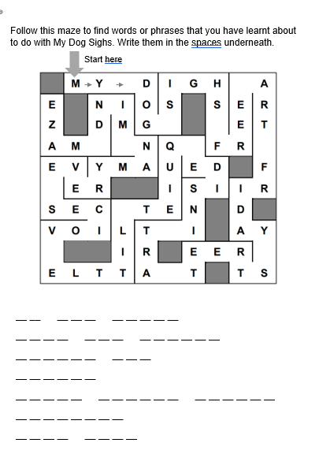
Take away
Notes:
(If local) Tell them about dates and location of Inside
The art event Inside that we learnt about earlier is taking place in Portsmouth from Friday 16th July to Sunday 1st August 2021. If you’re interested in seeing more of the amazing art that My Dog Sighs has been doing, meet his Quiet Little Voices and Everyman you can find all the details on the back of the take away activity sheet.
Worksheet B can be photocopied double sided and cut in half for them to take home. They can continue to think about mazes by following the maze and writing down the letters as they go aong on the lines below. They should then spell out words or phrases they have learnt in today’s lesson.

