Slide 1
My Dog Sighs
Key Stage 1
Key Stage 1

Slide 2
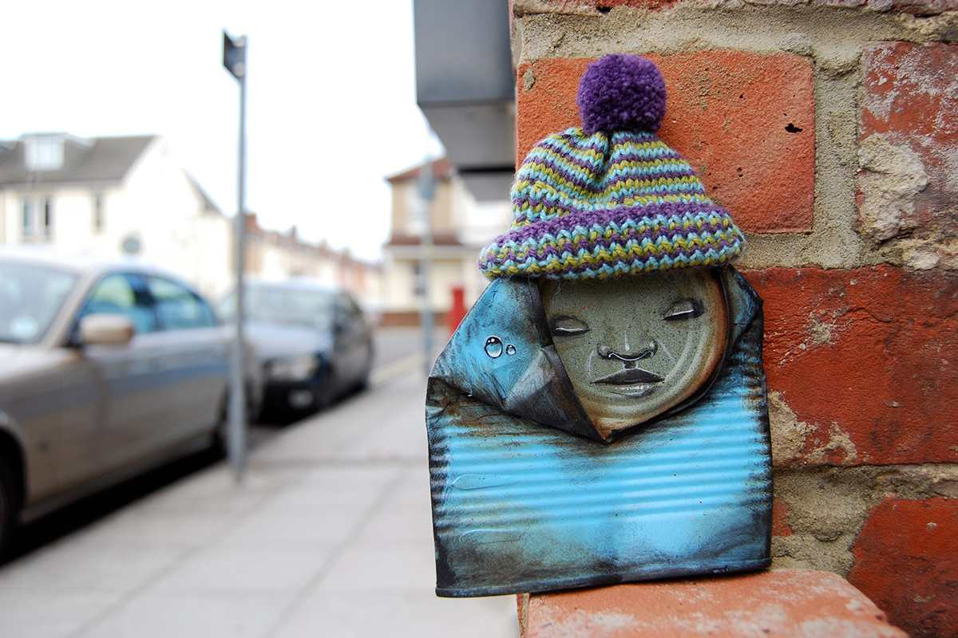
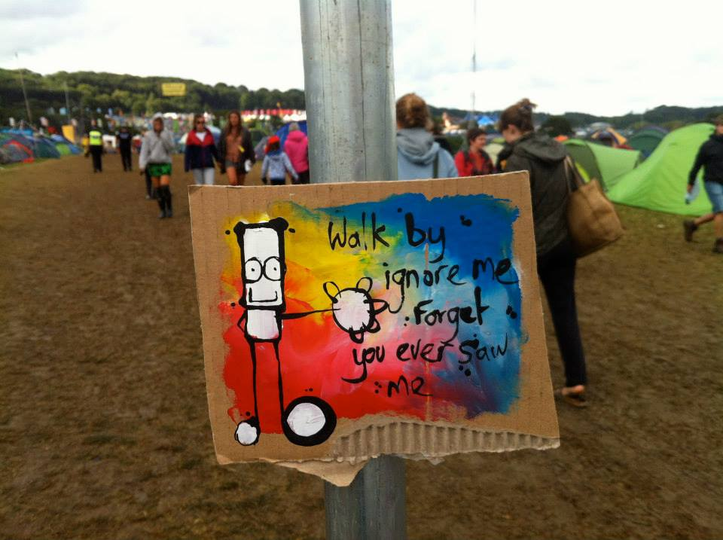
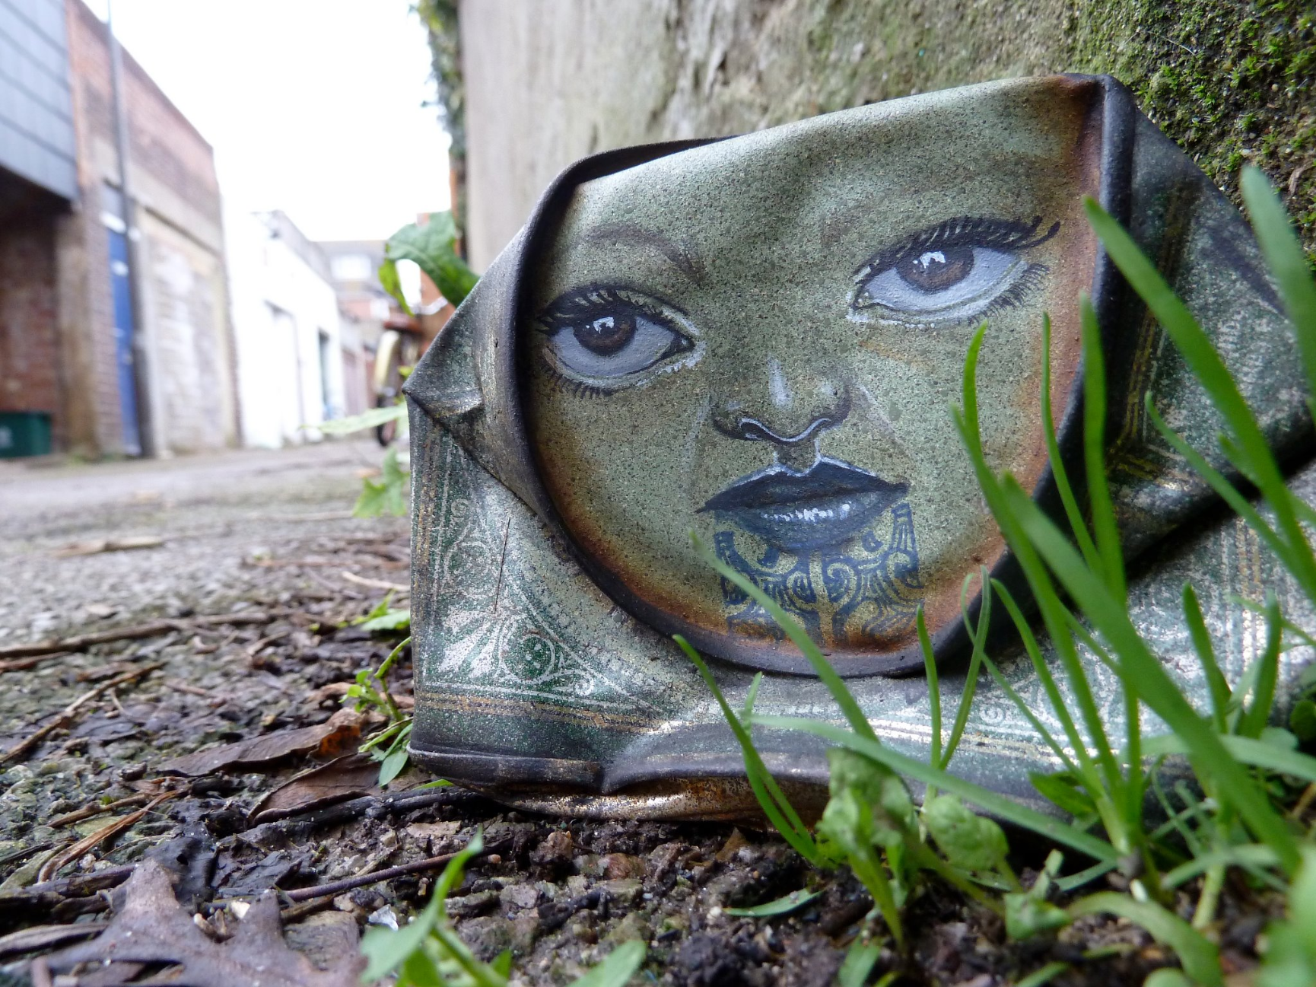
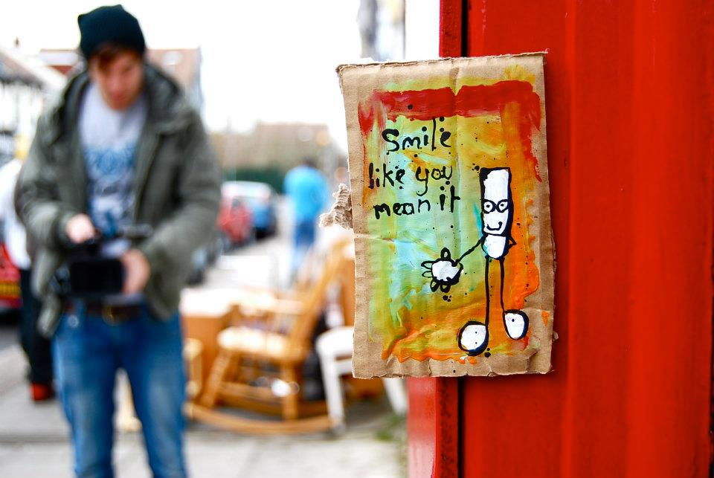
What are they?
How did they get there?
Which is your favourite?
Notes:
Have you ever been walking down the street and stumbled across something like one of these? (click to reveal a question at a time)
What do you think they are? (3 are paintings on cardboard, 1 is a squashed can painted with a face)
How do you think they got there?
Which is your favourite and why?

Slide 3
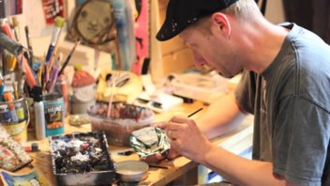
My Dog Sighs
Notes:
They were all created by an artist who is known as My Dog Sighs. Funny name hey?!
What is an artist? (Someone who creates things – it may be paintings, drawings, models and all sorts of other things.)
My Dog Sighs lives in Portsmouth and used to be a teacher.

Slide 4
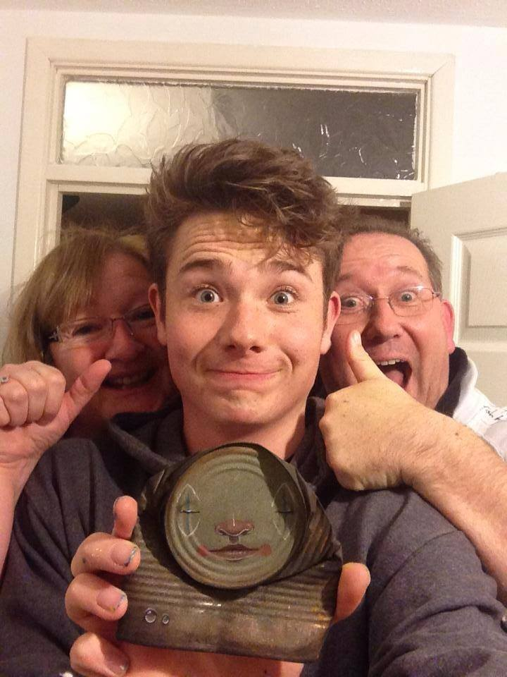
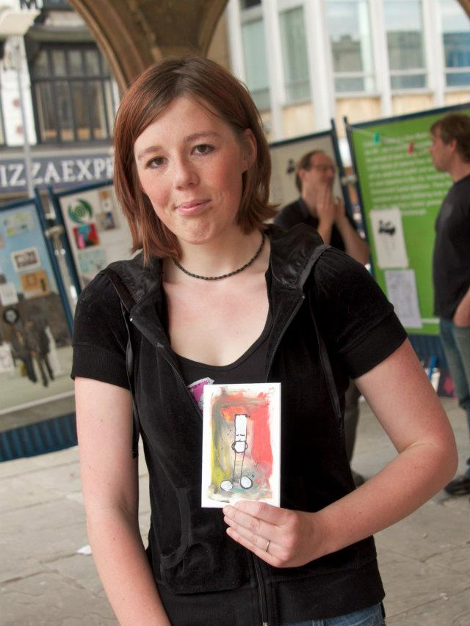
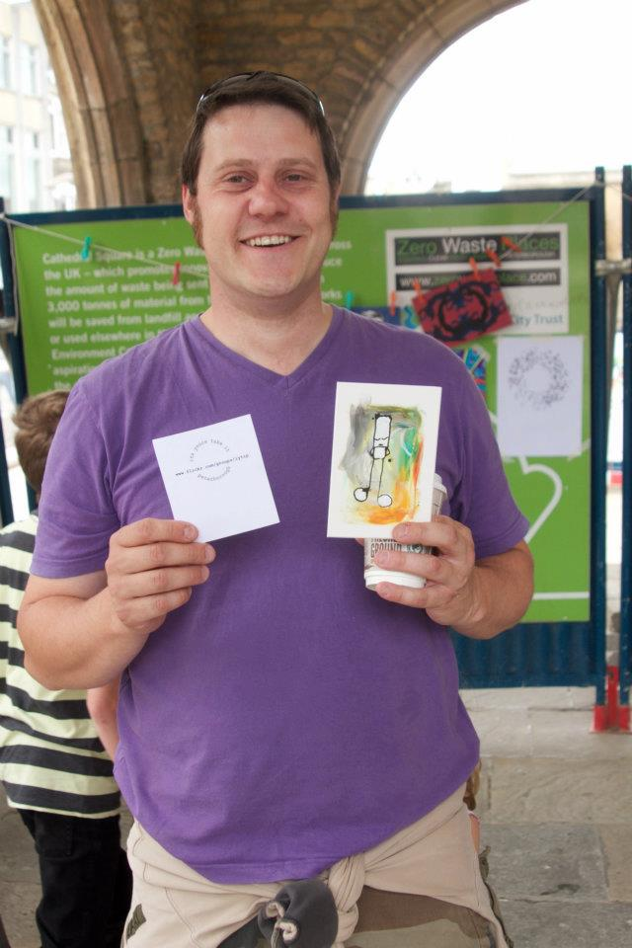
Free Art Friday
Free art, I’m yours. Take me home!
Notes:
10 years ago My Dog Sighs started leaving a piece of his art somewhere in Portsmouth every Friday. He would leave a little tag on it saying ‘Free art. I’m yours. Take me home.’ Here are some people who found some of his art. Since then Free Art Friday happens in lots of different places and people leave little pieces of their art for others to pick up. Why not start looking around you on a Friday as you walk down the street in case you stumble across something? Remember art doesn't have to just be something painted on paper, it could be anything that someone has created.

Slide 5
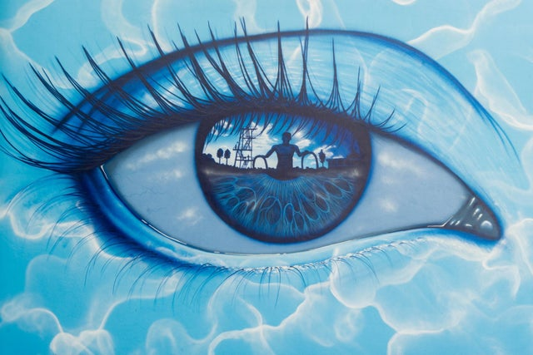
What do you notice?
What similarities and differences do you see?
What do you like or not like about them?
Notes:
(Optional slide – if you have time / feel this is suitable for your class.)
Since then My Dog Sighs has become a well-known artist and his artwork can be seen around the world.
Not only does he create little pieces of art from cans or on cardboard as you’ve seen, but he has become well known for painting unusual and colourful eyes.
These are just two examples. (click to reveal a question at a time)
What do you notice when you look closely at these two pictures of an eye? (In the shiny surface of the eyeball he has painted a reflection of an image – it may be people, places or stories.)
Is there something you particularly like about either of them, or something that you really don’t like?

Slide 6
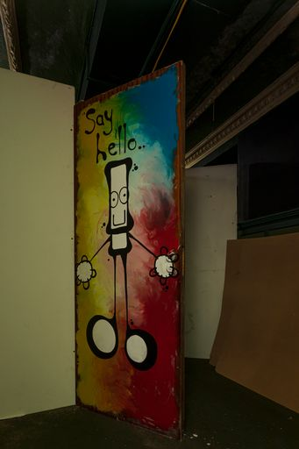
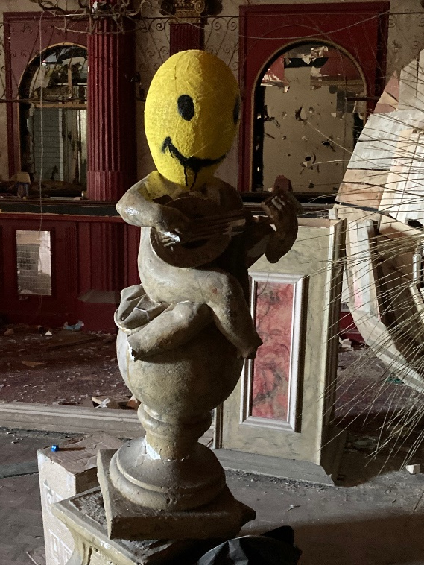
'Inside'
Notes:
My Dog Sighs is working on a new and exciting secret art project, the biggest he's ever done. This art project is called 'Inside'.
Can anyone guess what this project is about? (There is a clue in the name!)
This art project is in fact the whole inside of a building! My Dog Sighs has found a building that has been empty for 20 years and made it into a world full of strange little creatures that he’s made out of things that he’s found, and he has also drawn and painted art all over the walls. Everywhere you look in this building, you’ll find something unusual created by My Dog Sighs. He calls these creatures his ‘Quiet Little Voices’.
Why do you think he calls them his ‘Quiet Little Voices’?
These Quiet Little Voices are different feelings that the artist has. They may be happy, or sad; they may be playful, adventurous, quiet, excited. He says that these Quiet Little Voices help him do his art. Sometimes he feels happy or sad or playful and this shows in the art that he does.
Lots of his Quiet Little Voices are made out of everyday objects that he has found, big or small…What objects can you see that he has used? (willow, a statue from the building and..?)
Why do you think he uses things he has found?
It’s good for the environment to reuse things
Art can be made anywhere using anything - not just on paper
It’s cheap, no need to spend money buying it

Slide 7
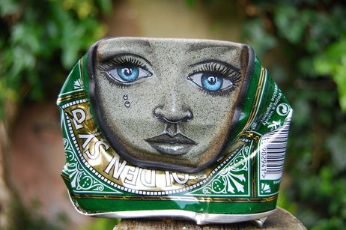
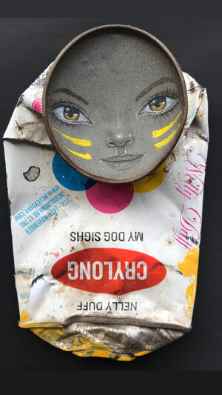
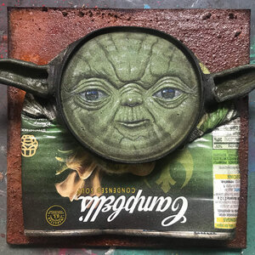
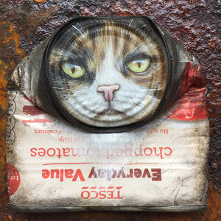
Which is your favourite?
What are these made from?
What else could you make a creature from?
Notes:
Here are some creatures that My Dog Sighs has created from objects that he has found. (Click to reveal a question at a time.)
Which is your favourite and why?
What are these creatures made from? (tins)
What else could you make the creatures from that are things that you’ve found? (bottles, cardboard boxes, pebbles)
Which part of the body has he painted on them? (faces)
We’re going to make our own ‘Quiet Little Voice’ creature, and we’re going to especially think about how we can make the face stand out like these do.
(Move on to lesson plan for either activity 1 or 2)

Slide 8
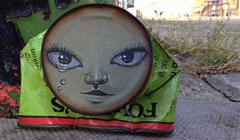
Feelings and emotions
sad
lonely
loved
excited
peaceful
surprised
tired
annoyed
cross
playful
funny
happy
Notes:
Give out post-it note to each child.
You are going to create your own creature but we’re going to start by thinking about feelings.
Think about a feeling (or if you’re doing option B then up to 3 feelings) that you want your creature to represent when you make it. Would anyone like to tell us some feelings? There are also some ideas here. (click to reveal a new word at a time.)
If you’ve decided which feeling(s) you’re going to use then write it on your post-it as a reminder.
Ask for some of their ideas.
Keep the post-it by you so that you don’t forget the feeling(s) you’ve chosen when you make your creature.

Slide 9
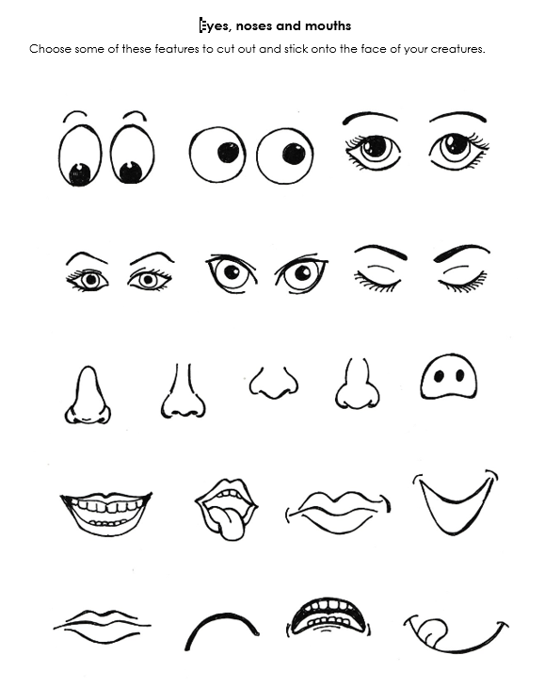
Activity 1: make a creature
Notes:
Activity 1
Your task is to make your own creature using a found object, trying to think about the feeling you want it to show.
Choose the object you will use.
Then cut a circle or oval on a piece of paper, the width of your object. This will be the face.
Cut out eyes, nose and mouth. (You can either: A) take photos of the children, print them out and let them cut out eyes, nose and mouth – they could swap features with each other! B) get the to find faces from magazines to cut features out of. C) Use worksheet A to cut out their chosen features.
Stick the features on the circle then stick the circle on the object.
Finish off by adding other features – tentacles, arms, legs, tails, whiskers???

Slide 10
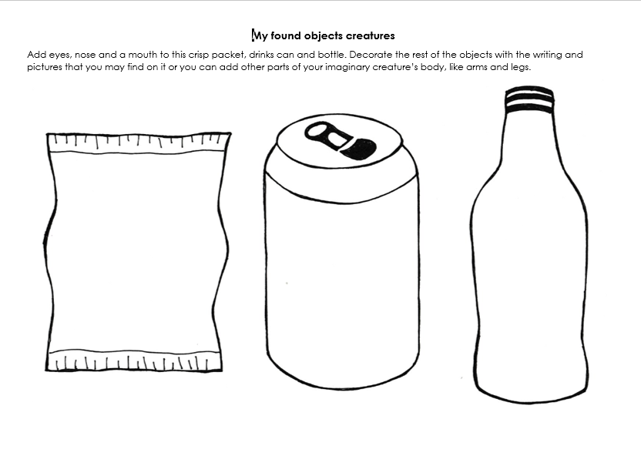
Activity 2: make a creature
Notes:
Activity 2
Your task is to decorate these objects (crisp packet, can and bottle) on your worksheet (worksheet B) to make them into creatures, trying to think about the feelings you have chosen for them to look like.
Cut out eyes, nose and mouth. (You can either: A) take photos of the children, print them out and let them cut out eyes, nose and mouth – they could swap features with each other! B) get the to find faces from magazines to cut features out of. C) Use worksheet A to cut out their chosen features.)
You can then decorate the rest of the creatures by adding whiskers, freckles, arms, legs, tails etc. Or you could make it look more like the original object by drawing a drink / food logo on the remainder of the outline.

Slide 11
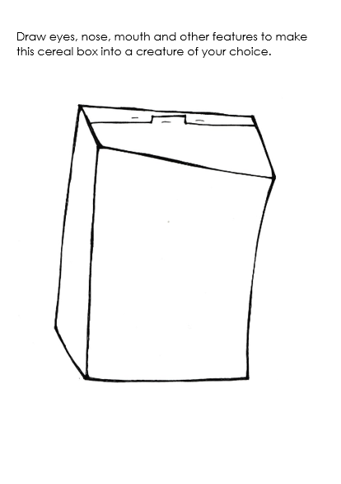
Take away
Notes:
The art event Inside that we learnt about earlier is taking place in Portsmouth from Friday 16th July to Sunday 1st August 2021. If you’re interested in seeing more of the amazing art that My Dog Sighs has been doing, meet his Quiet Little Voices and more of his creatures made out of found objects you can find all the details on the back of the take away activity sheet.
Worksheet C can be photocopied double sided and cut in half for them to take home. They can continue to create their own creature on the outline of a cereal packet. Or they can find a box at home and make it into their creature.

